Slide 1


AdePT project
porting particle transport simulation to oneAPI
-user experience-
Daniel-Florin Dosaru
oneAPI DevSummit at ISC
June 22nd
Notes:
Hello everyone, I am Daniel and I will present my user experience in porting particle transport simulation, the AdePT project, to oneAPI.

Slide 2
About me
Master student in Computer Science at EPFL
Technical Student at CERN
dosarudaniel@gmail.com
Linkedin, Github
Notes:
I am a master student in Computer Science at EPFL in Switzerland, and I am working on my thesis at CERN from February this year.
When I started I had some C++ experience, but no prior SYCL experience.

Slide 3
Content
Background in High Energy Physics
Time scales and magnitude of computing problems
User experience in porting simulation code (AdePT project) to oneAPI
Notes:
I will start by giving you a bit of a background about computing in High Energy Physics,
About time scales and magnitude of computing problems faced by physicists who are collecting and analyzing data coming out from experiments at CERN
After that I will describe what is AdePT and my user experience in porting the AdePT project to oneAPI.

Slide 4
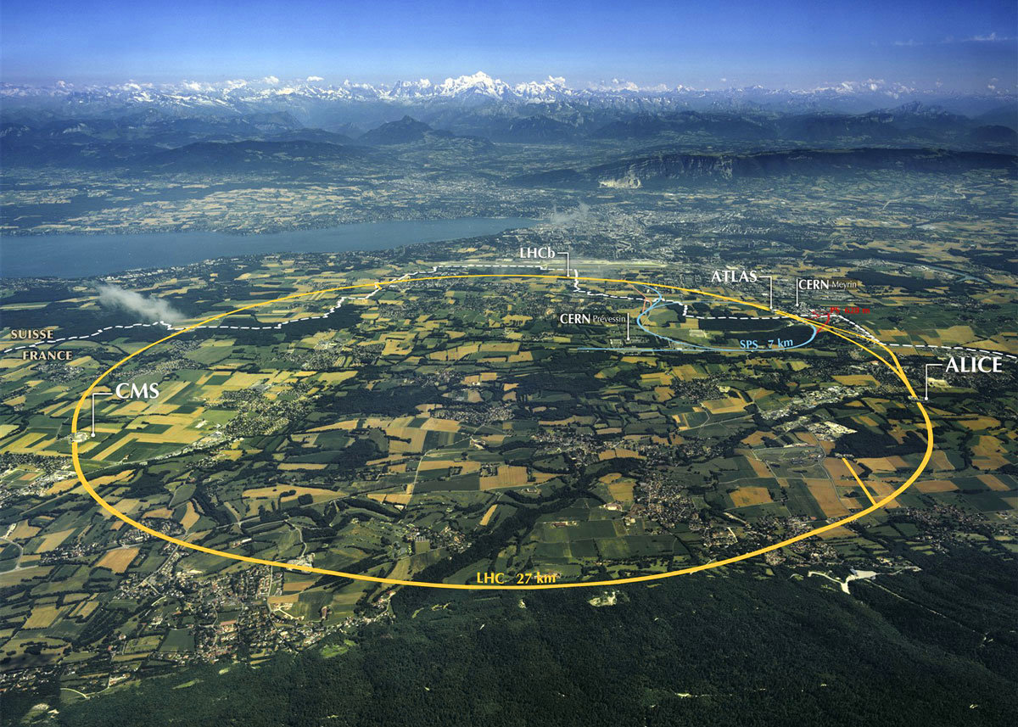
About CERN and Large Hadron Collider (LHC)
  27 km circumference
  Between 50 and 175 meters underground
  The highest-energy and largest particle accelerator ever built
  Rare phenomena are studied, huge quantities of recorded collisions (events) must be considered
Notes:
The Large Hadron Collider at CERN, located at Swiss-French border near Geneva, Switzerland,
is the largest particle accelerator in the World and the biggest scientific instrument ever built.
It has 27 km circumference and it is buried between 50 and 175m underground.
We study rare phenomena with huge quantities of recorded collisions (events) and data.

Slide 5
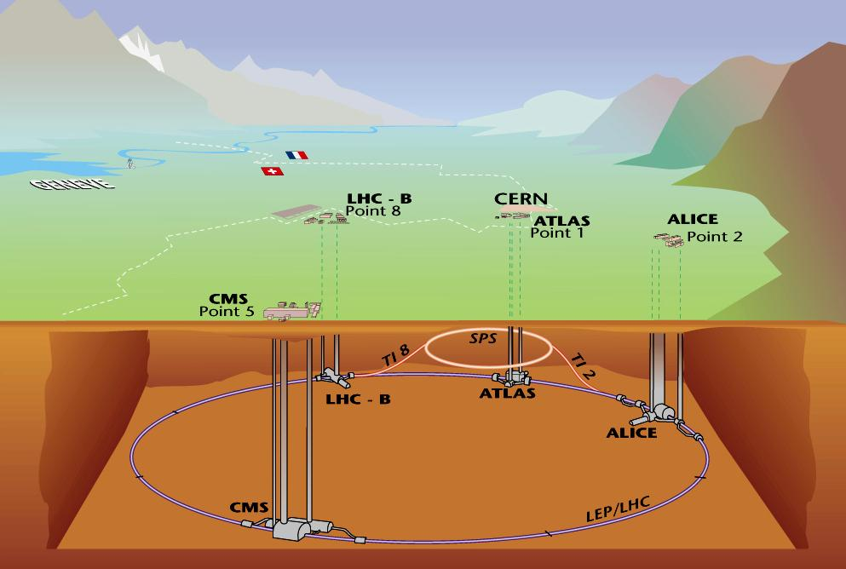
Physics experiments at the LHC
  LHC: one accelerator, four (main) experiments: ALICE, ATLAS, CMS, LHCb
  The four experiments share the same beams and take data at the same time
  Different physics reach: different detector technologies, different readout speeds, different data volumes
Notes:
There are four experiments (ALICE, ATLAS, CMS, LHCb) - (A Large Ion Collider Experiment, A Toroidal LHC ApparatuS, Compact Muon Solenoid, LHC-beauty)
located underground at four points where proton beams intersect and collide at 13 Tera electron VoltS total collision energy.
The aim of the LHC's detectors is to allow physicists to test the predictions of different theories of particle physics, including measuring the properties of the Higgs boson
There are over 10,000 scientists and engineers from hundreds of universities and laboratories from more than 100 countries participating in these experiments. Each of the experiments is organized in the form of Collaboration with up to 3000 participants.

Slide 6
Upgrade schedule
CPU needs (per event) will grow with track multiplicity (pileup) and energy
Storage needs are proportional to accumulated luminosity
Run4
ATLAS
+
CMS
Run3
ALICE
+
LHCb
Run2
Run1
2009-2013
2015-2018
2021
time
Notes:
The planning and construction of the LHC and the experiments took almost two decades. During this period the detectors had to be built and carefully simulated to assure that we will be able to disentangle signal from the background.
After successful start and the first two data taking periods (Run 1 & 2), the LHC and detectors are currently undergoing maintenance work in order to prepare for Run 3 which will see an increased collision rate in the machine and improved performance of ALICE and LHCb detectors. This will be followed by Run 4 where the proton-proton collision rate will be significantly increased and that will be matched by increased data taking performance of two remaining detectors (ATLAS and CMS).

Slide 7


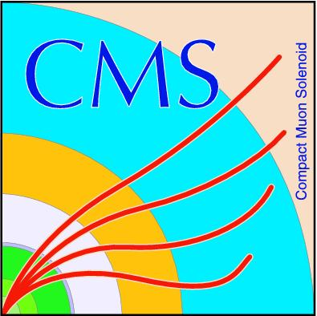

Computing @ LHC
huge detectors
  physical size and number of electronic channels
large collaborations
  thousands of people
  hundreds of institutions
decade of lead time before the construction
decade of construction and commissioning
at least two decades of exploitation and continuous upgrades
huge time span for software
we have to: preserve, proces and re-process our data from different stages.
Notes:
The computing for LHC was always expected to be a challenge especially given the scale of the detectors and collaborations involving thousands of people
from hundreds of institutions.
This involves:
10 years of lead time before the construction
10 years of construction and commissioning and
at least 20 years of exploitation and continuous upgrades
On a software scale, this represents a huge time span during which many things can change and yet,
we must be able preserve, proces and re-process our data from different stages.

Slide 8

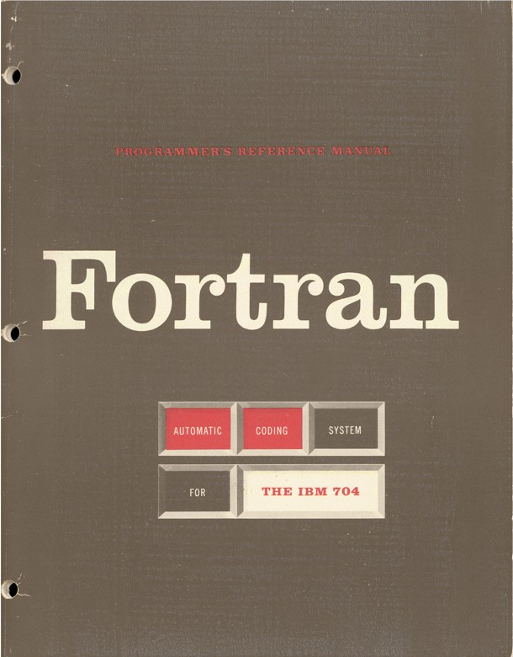
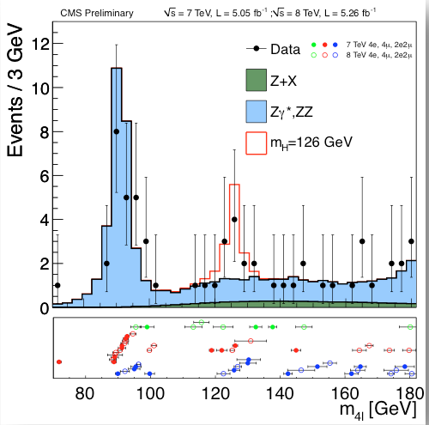
Migration from Fortran to C++...
Notes:
Back in mid 90s the High Energy Physics community decided to part with fortran and switch to C++ as the main programming language.
In absence of other solutions, at CERN, people tend to invente themself the missing tools.
An example is ROOT , an object-oriented framework originally designed for particle physics data analysis (data mining and visualisation).
It also provides an on-disk data format for C++ object persistency which is now widely used in other fields of science.
(Another example is the world wide web which was invented at CERN to solve the problem of uniformly sharing documentation between scientists and engineers spread around the world.)

Slide 9
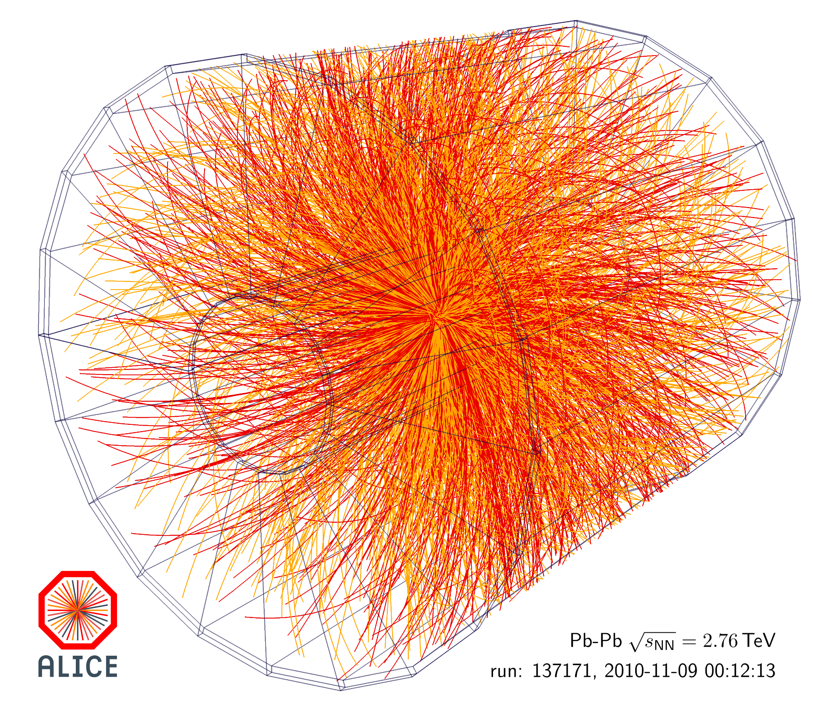
C++ @ LHC
Millions of lines of code on C++ to support :
  Raw data reconstruction
  Simulation
  Analysis
Recently, there was a significant penetration of python in particular on the end user analysis side.
Notes:
By now each of the experiments has written many millions of lines of code in C++ to support the main use case of
Raw data reconstruction, Simulation and Analysis
Lately, there was a significant penetration of python.
In particular on the end user analysis side (using pyRoot binding) thus shielding to some extent the end users/physicist from underlying core framework in C++.

Slide 10
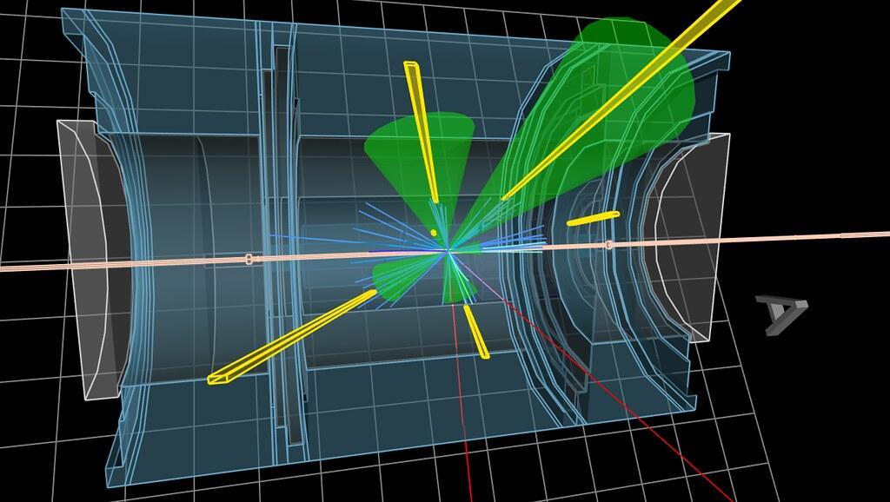
C++ @ LHC - Detector simulation
Simulation of the interaction of elementary particles with matter
  also written in C++ on top of Geant4 toolkit developed by HEP community in collaboration with other scientific communities
Simulating the physics requires large amount of computing resources
  45-90% of total computing budget goes to simulation
Notes:
Detector simulation is another key component and is also written in C++ on top of Geant4 toolkit developed by High Energy Physics community
Simulating the physics interactions along with the background and detailed detector response consumes very significant amount of computing resources
depending on the details of experiment, 45-90% of total computing budget goes to simulation
In summary, C++ is deeply rooted in the core software of our experiments and this will not likely to change.
This makes us look forward to evolution of the language with great interest.

Slide 11

Worldwide LHC Computing Grid
Our 15 years old distributed computing and data storage infrastructure
spread over 150 computing centres
40 countries
It currently operates about
1M of commodity CPU cores
1EB of storage.
and it is growing...
Notes:
Given the global nature of High Energy Physics collaborations, it is not a surprise that CERN’s take on solving computing problem came out to be equally distributed.
The WLCG -
Worldwide LHC Computing Grid is a distributed computing and data storage infrastructure spread over 150 computing centres in 40 countries.
It currently operates about 1 million commodity CPU cores and it has 1 ExaByte of storage.
It was born before Clouds took over but still serves us well.

Slide 12
The end of an era...
In the past benefited from a significant underlying simplifications:
  One platform (linux)
  One architecture (x86)
  One compiler (gcc)
Already the end of the Run 1 it was clear that our life is going to get significantly more complicated:
  Growing needs for computing resources cannot be matched by the growth of the Grid under the fixed budget
Distributed funding → the end of homogenous platform dream
Notes:
While we learned over the past 15 years how to master distributed computing, we also benefited from a significant underlying simplifications:
We had one platform (linux), one architecture (x86) and one main compiler (gcc).
Already at the end of the Run 1 it was clear that our life is going to get significantly more complicated:
Our growing needs for computing resources fueled by the improvements in the machine (in collision rate - also called luminosity)
and detectors (readout rate)
cannot be matched by the growth of the Grid under the fixed budget.
Moreover, since distributed computing means also distributed funding,
there is a growing pressure from various funding agencies to complement our Grid resources with existing HPC capacity
which implies tuning our application for a specific platform and
that marked the end of our homogenous platform dream.

Slide 13
Why HPCs and GPUs
Forced to look into hardware accelerators such as GPUs
By now the experiments are making very significant use of GPUs for their online and offline reconstruction.
Since a large fraction of CPU time is actually spent in simulation we need to look into how we could benefit from GPUs in simulation.
Notes:
As a result we were forced to look into possible use of the hardware accelerators such as GPUs
and by now the experiments are making very significant use of GPUs for their online and offline reconstruction.
Knowing that a large fraction of CPU time is actually spent in simulation,
there was a clear need to look into how we could benefit from GPUs in simulation.

Slide 14
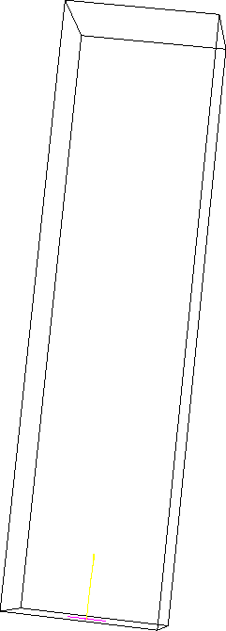
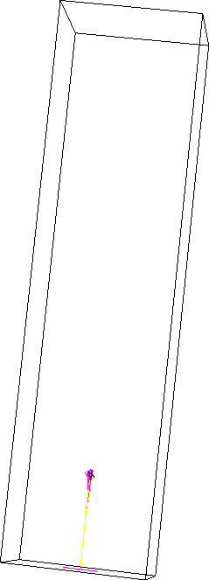
AdePT Project
1 GeV
80 GeV
General, high energy physics particle transport simulation is generally not well suited for running on hardware accelerators such as GPUs
  However, some aspects of simulation, such as simulation of developing showers in the calorimeters , could make use of GPUs:
    very time consuming
    require only a subset of physics processes to be ported to GPU
Accelerated Demonstrator of Electromagnetic Particle Transport
  R&D project aiming to port Electromagnetic (EM) physics transport components of Geant4 physics simulation to GPU and provide a plug-in applicable to specific “regions”.
Specifically targeting calorimeter simulations
Slide adapted from Stephan Hageboeck’s slides
Notes:
Given the random nature of particle propagation through detectors and complexity of their geometries,
particle transport simulation is generally not well suited for running on hardware accelerators such as GPUs.
However, some aspects of simulation, such as simulation of developing showers in the calorimeters, could make use of GPUs,
but this is very time consuming and it requires only a subset of physics processes to be ported to GPU
One thread takes one particle and process it until it will lost its energy,
but because they have a stochastic behaviour we have cache problems and branch prediction is tricky.
This is really bad for the CPUs in the sense that it is hard to optimize, but it could map well on GPU architectures.
During development we aim to understand portability/implementation/optimisation of porting components geometry description,
electromagnetics physics, field propagator to GPU.
We aim to implement and evaluate different data models, scheduling strategies and optimise performance as well as understand limitations.
Eventually, we want to demonstrate and compare a realistic simulation workflow on CPU and GPU.
You can see on the slide electromagnetic showers representations with different level of the energy. The one on the right represents what we will have to simulate after upgrade.

Slide 15
Particle transport workflow
queue of track indices scheduled for the current step
contiguous
next slot atomic
no slot reuse
different for e+/e-/gamma
tracks
active
queue scheduled for the next step
next active
Tracks
Physics Kernels
scheduled on the content of the active queues, no “holes”
electrons
active
TransportElectrons<<<..., electronsStream>>>
next step
next active
ionization
copy to host (hits)
positrons
active
brems
TransportPositrons<<<..., positronsStream>>>
next active
compton, photoel
annihilation
conversion
gammas
active
TransportGammas<<<..., gammasStream>>>
next active
physics kernels populate the “next” queues (secondary tracks and surviving primaries)
events sync
swap active/next queues
Notes:
Particle transport in detectors is simulated in “steps” aiming to move particles in the detector until either the next physics interaction (which is random) or the next detector boundary, whichever is closer.
we simulate only positrons, electrons and gammas because these are the main particles concerned by electromagnetic physics, and taking the majority of simulation time on CPU
Here is the stepping loop workflow
Physics processes for positrons, electrons and gammas are implemented using the G4HepEm library.
Data containers are organized as arrays of structures storing a random number generator state per track to assure reproducibility.
Each particle type has a separate container with unique slot numbers .
Particle Transport kernels co-exist in different streams per particle type and the energy deposits lost by particles during the step, and other information allowing to simulate the electronic detector response

Slide 16
oneAdePT
The current AdePT code depends on external physics (G4HepEm) and geometry (VecGeom) libraries.
  Currently targeting the NVIDIA/CUDA platform
  In future: target various CPU and GPU targets starting from the same source
oneAdePT is our attempt to port AdePT point in time snapshot to oneAPI. It includes:
    AdePT core utilities and particle transport
    RUNLUX++ random number generator
    magnetic field routines
    G4HepEm library.
The goal was to get experience in CUDA code migration to DPC++ and evaluation of DPC++ ability to use with legacy CUDA libraries (VecGeom).
Source code: https://github.com/dosarudaniel/oneAdePT
Notes:
The current AdePT code depends on external physics (G4HepEm) and geometry (VecGeom) libraries.
At present the development is targeting the NVIDIA/CUDA platform but it is clear that, given our distributed resources and funding,
we will eventually have to effectively target various CPUs and GPUs starting from the same source which made us look into oneAPI and SYCL as a possible solution.
oneAdePT is our attempt to port an AdePT point in time snapshot to oneAPI and SYCL.
This includes AdePT core utilities and particle transport, RUNLUX++ random number generator, magnetic field routines and G4HepEm library.
Left out of the oneAdePT scope are the external dependencies such as VecGeom/VecCore libraries.
These are used for detector geometry description and navigation between volumes and materials.
These are left out since they were judged to be too complex to port to SYCL and they exist as CUDA libraries.
So, our main goal was to experience CUDA code migration to DPC++ and evaluation of DPC++ ability to use with legacy CUDA libraries such as the Vectorized Geometry library.
(Why to complex: It has been designed to maximize use of virtual functions and this is exactly what I can not do. The entire project has to be rewritten. There was one attempt for just a couple of geometries - non virtual dispatcher - the switch statement.)

Slide 17
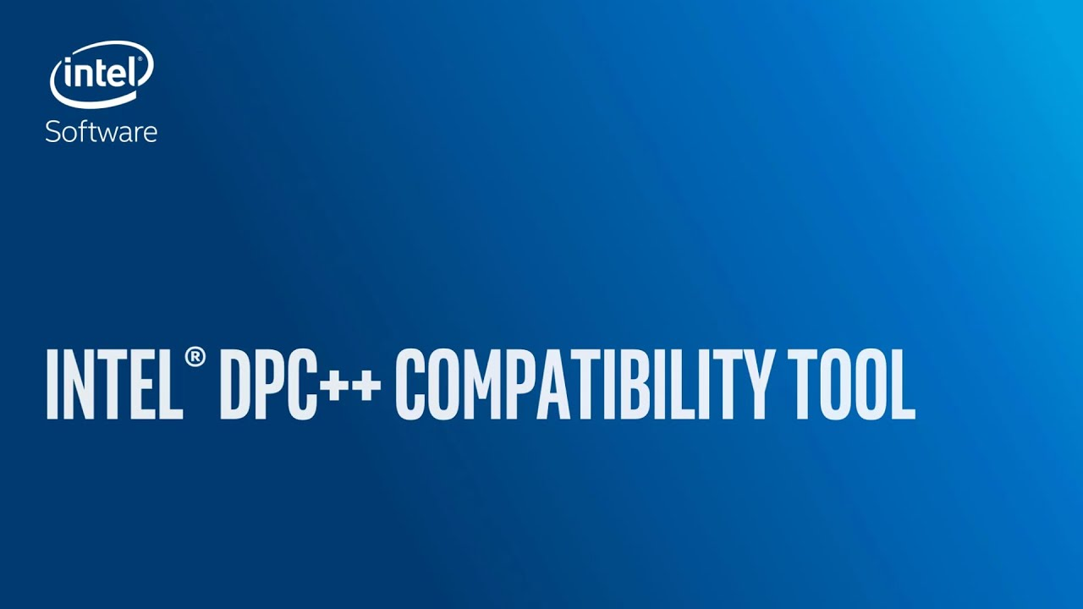
Migration from CUDA to DPC++
We used Intel® DPC++ Compatibility Tool (dpct) to bootstrap the porting process
There are some unavailable equivalent API’s in SYCL which we had to rewrite
But, the tool has useful diagnostics messages (+ centralized reference)
  Validating use of work-group sizes
Notes:
To migrate the CUDA code to DPC++ we used Intel® DPC++ Compatibility Tool (dpct) and we bootstrapped the porting process with reasonable success
There were some unavailable equivalent API’s in SYCL which we had to rewrite
But, the tool has useful diagnostics messages plus a nice centralized reference for each diagnostics message
Also, it includes some validations for the work-group sizes for example.

Slide 18
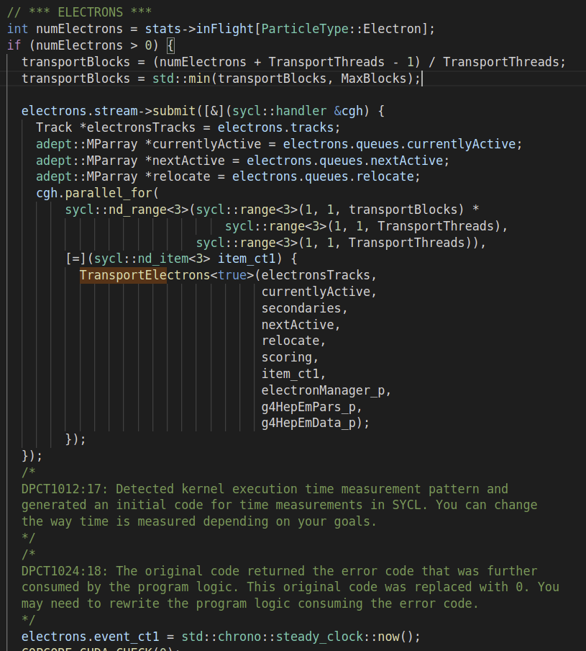
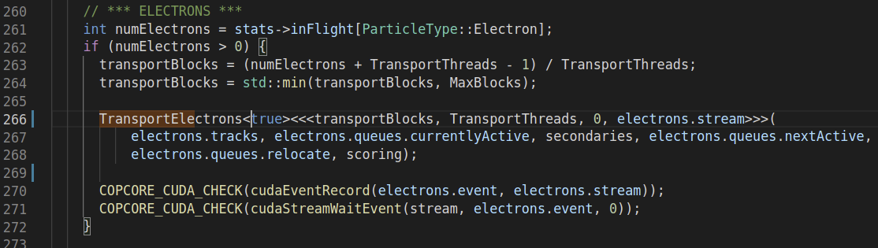
Intel® DPC++ Compatibility Tool in use
.cu file
.dp.cpp file
Notes:
Here is a conversion example generated with the Intel DPC++ Compatibility Tool.
It transformed a cuda kernel call into a parallel_for structure from which the converted SYCL kernel was called.

Slide 19
Compilation experience
Used Intel’s open source DPC++ compiler (clang++) since we really needed to use the Codeplay contribution to DPC++ which adds support for NVIDIA GPUs
  Intel’s DPC++ does not have support for non-Intel target
  For our use case, support for CUDA BE in DPC++ is important
Helpful and enthusiastic SYCL developer community
Complexity of the full software stack
Documentation is hard to find (not centralized)
User community not yet well established
  Few examples from other users
Converted source compiled successfully
Notes:
We had to use Intel’s open source DPC++ compiler (the clang++) since we really needed to use the Codeplay contribution to DPC++ which adds support for NVIDIA GPUs.
Unfortunately, Intel’s DPC++ does not have support for non-Intel target
For our use case, support for CUDA BE in DPC++ is important
Ideally the plugin support should be extended to other targets (such as HIP)
During the compilation process of the generated code we hit some inconvenients:
We found a very helpful and enthusiastic SYCL developer community,
but this unfortunately cannot replace centralized documentation and examples
the complexity of the full software stack is quite high:
it has many layers and Backends with possible runtime differences:
the Documentation was quite hard to find ( it was not in one place) and
it is far more focused on the Intel’s DPC++ compiler rather than the open source compiler clang++
The users community is not well established yet - Few examples are indexed on the web
because not yet many users are sharing their experience and helping themselves
After about two months, we were able to compile the Converted source

Slide 20
SYCL standard limitations
SYCL kernel cannot call a virtual function
  Addressed by adding a non-virtual dispatch layer in AdePT ✅
SYCL kernel cannot use a non-const global variable
  Added the variables as kernel parameters ✅
SYCL kernel cannot call through a function pointer
  Some abstract classes were converted to concrete classes ✅
Math functions in the kernel must be used from sycl:: namespace
  Using preprocessor macros ✅
Notes:
As stated in the documentation, we also hit some of the SYCL limitations because a SYCL kernel cannot :
call a virtual function
Addressed by adding a non-virtual dispatch layer in AdePT ✅
use a non-const global variable
Added the variables as kernel parameters ✅
call through a function pointer
Some abstract classes were converted to concrete classes ✅
For these we had to find different hacks - not real solutions such as..
Other restriction that we faced was using math functions from sycl namespace. When we tried using math functions from std:: namespace the compiler crashed with an error message that was not so useful - I will show it in the next slide. We had to use a preprocessor macro since the headers in which the error occurred were imported by a non sycl application as well.

Slide 21
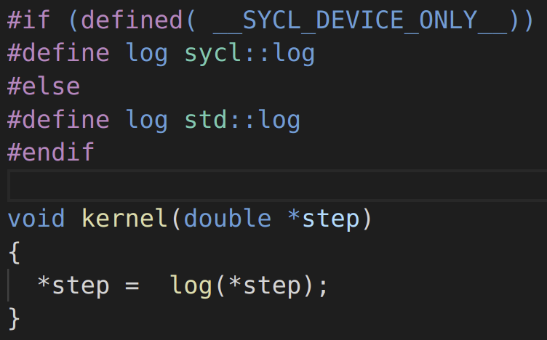
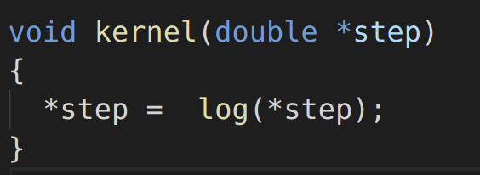
Using math functions from std::
Calling std:: math function in the SYCL kernel:
fatal error: error in backend: Undefined external symbol "log"
clang-13: error: clang frontend command failed with exit code 70
or
fatal error: error in backend: Cannot select: t53: f64 = fcos t52
t52: f64 = fdiv t51, t37
test12.cpp
Math functions which needed this hack:
log, exp, cos, sin, pow, frexp, ldexp, modf
Other functions which did not need this hack:
abs, fabs, sqrt
Reported on github
Notes:
As I mentioned calling some std:: math function in the SYCL kernel resulted in a compiler crash and the error message did not helped much -
I could not see where exactly the error occurred from this “fatal error: error in backend” message.
As the suggested solution was to use the math functions from the sycl namespace and
the headers files in which std:: math functions were called were also imported by a non sycl application
we found a workaround to this problem as shown in the figure on the right using preprocessor macros.
By “some” function I mean log, exp, cos etc. But there were other functions that did not need this: std::abs, std::fabs, std::sqrt as they did not produced such an error.

Slide 22
Usage of std:: math function (context)
G4HepEm
header files
G4HepEm
header files
(std:: math calls)
oneAdePT
SYCL application
AdePT
non SYCL application
#preprocessor macros
Notes:
As I mentioned I could not just use the sycl namespace in the G4HepEm header files because those are used by a non SYCL application
to solve it I had to use the trick with preprocessor define only in oneAdePT
I had to remove the “std::” from G4HepEm header files

Slide 23

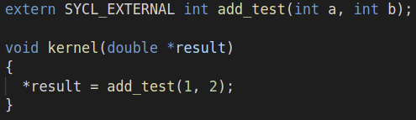
Limitations: supporting a 3rd party library (1)
No support for 3rd party libraries: cuda compiled libraries - current blocker
basic_add.cu
$ clang++ -fgpu-rdc --cuda-gpu-arch=sm_75 field.cu -c
basic_add.o
test.cpp
$ clang++ test.cpp basic_add.o -fsycl -fsycl-unnamed-lambda -fsycl-targets=nvptx64-nvidia-cuda-sycldevice
Linking error: "ptxas fatal : Unresolved extern function '_Z11my_add_testii'"
basic_add.o is not passed to ptxas and thus it can’t find required symbol.
Check the github discussion on this topic: https://github.com/intel/llvm/discussions/3627
Other compilation and linking trials described in this document
Notes:
Unfortunately, he hit another problem: there is no support for 3rd party libraries (calling a cuda kernel from a SYCL kernel) and this is our current blocker
This code on the slide is just a simplified example.
As you can see in the basic_add.cu there is an add_test cuda kernel which is called from the SYCL kernel in the test.cpp below.
I was able to create the basic_add object file, but it I got this Unresolved extern function error at link time.
The helpful SYCL community on github helped me to figure it out at
which step the error occurred and I discovered that the basic_add object file is not passed to the PTXAS and thus it can not find the required symbol.

Slide 24
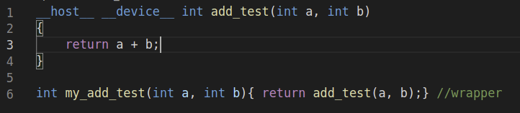
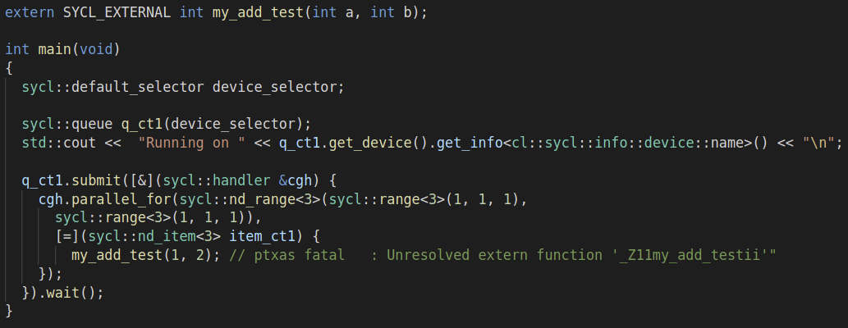
Limitations: supporting a 3rd party library (2)
Trying to use a cpp wrapper:compiling
basic_add.cu
nvcc -dc basic_add.cu
basic_add.o
test.cpp
test.o
$ clang++ -c test.cpp -o test.o -fsycl -fsycl-targets=nvptx64-nvidia-cuda-sycldevice -fsycl-unnamed-lambda
Suggested idea https://stackoverflow.com/a/64527623
Notes:
In a similar fashion, calling the my_add_test wrapper from parallel_for structure produce the same error.
Check this out: https://stackoverflow.com/a/64527623

Slide 25
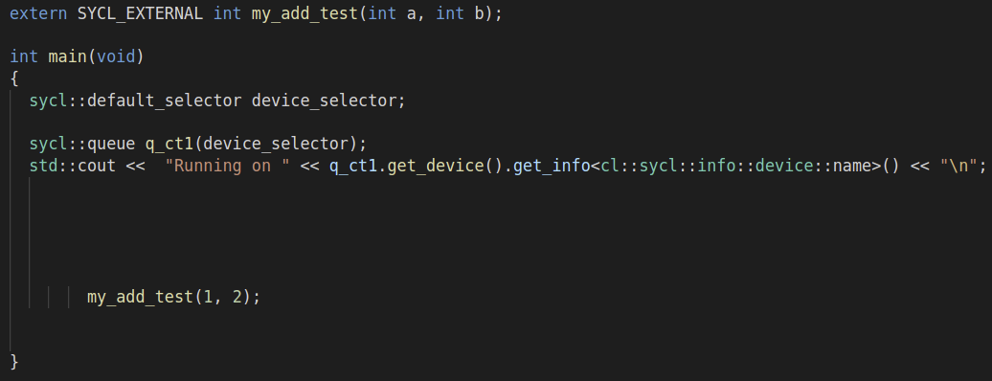
Limitations: supporting a 3rd party library (3)
Trying to use a cpp wrapper:compiling
basic_add.cu
nvcc -dc basic_add.cu
basic_add.o
test.cpp
test.o
$ clang++ -c test.cpp -o test.o -fsycl -fsycl-targets=nvptx64-nvidia-cuda-sycldevice -fsycl-unnamed-lambda
Suggested idea https://stackoverflow.com/a/64527623
Notes:
But, after removing the SYCL code, this version links and runs just fine
as the my_add_test function is not called now from the device code, but from the host code.

Slide 26
Limitations: supporting a 3rd party library (4)
Trying to use a cpp wrapper:compiling
basic_add.o
nvcc -dlink -o add.dlink.o basic_add.o
add.dlink.o
test
test.o
$ clang++ test.o add.dlink.o basic_add.o -o test -fsycl -fsycl-targets=nvptx64-nvidia-cuda-sycldevice -fsycl-unnamed-lambda -L/usr/local/cuda-11.1/targets/x86_64-linux/lib/ -lcudart
Linking error: "ptxas fatal : Unresolved extern function '_Z11my_add_testii'"
Notes:
Here is the entire workflow of linking and the same error message that haunted us

Slide 27
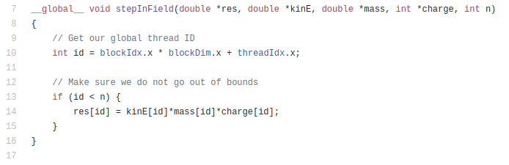
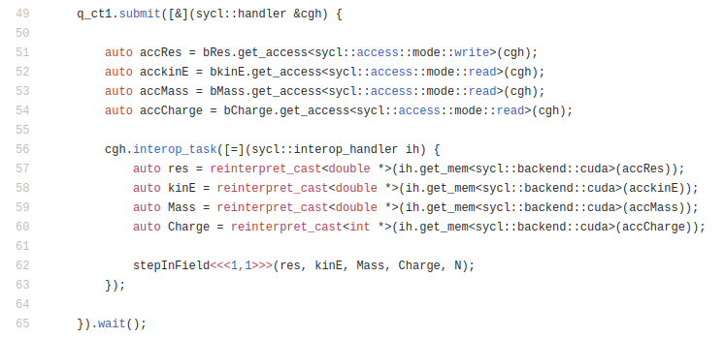
Attempting to use interop_task
Note: The interop_task and host_task commands are only callable from the command group scope.
Source code
Notes:
Being in contact with Codeplay, I found out that one possible solution to our problem would have been interop_task, but these are only callable from the command group scope.
And because I needed to call a third party cuda compiled library from the SYCL kernel
which is off course outside the command group scope - I could not use this nice feature.
Instructions:
To compile:
clang++ -std=c++17 --cuda-gpu-arch=sm_50 -I/home/dadosaru/sycl_workspace_may_2/llvm/build//include/sycl/ -g test13.cu -L/home/dadosaru/sycl_workspace_may_2/llvm/build//lib -lOpenCL -lsycl -L/usr/local/cuda-11.1/targets/x86_64-linux/lib/ -lcudart -o test13
To run:
dadosaru@pcphsft106:~/oneAdePT/tests$ SYCL_DEVICE_FILTER=gpu ./test13
Running on GeForce RTX 2080 SUPER
result = 6 ( Expected: 6 )
dadosaru@pcphsft106:~/oneAdePT/tests$ SYCL_DEVICE_FILTER=cpu ./test13
Running on Intel(R) Xeon(R) CPU E5-2630 v3 @ 2.40GHz
result = 0 ( Expected: 6 )

Slide 28
Conclusion
Experience in porting particle transport simulation (within the context of AdePT) showed that SYCL has a potential to be very useful towards support for heterogeneous platforms
oneAPI offers a large set of tools and flexibility for Intel devices
The Intel® DPC++ Compatibility Tool is a great tool to start with CUDA code migration
Caveats:
No compiler with full SYCL 2020 standard (rel. 2021) support yet
SYCL does not integrate well with cuda environment, yet (especially with 3rd party libraries)
clang++ compiler is still rapidly evolving
Suggestions:
Better organized documentation per compiler release + user examples would help building the critical mass and help users help themselves
We would love to see:
  the plugin support extended to other targets in the future
  support for virtual function calls and 3rd party libraries
Notes:
In conclusion, Experience in porting particle transport simulation (within the context of AdePT) SYCL has a potential to be very useful towards support for heterogeneous platforms
oneAPI offers a large set of tools and flexibility for Intel devices and
the Intel® DPC++ Compatibility Tool is a great tool to start with CUDA code migration since it can automatically migrate many of files in just a few seconds and it tells us were to add our manual contribution
Some caveats that need to be mentioned here are:
There is no compiler with full SYCL 2020 standard support yet
SYCL does not integrate well with cuda environment, yet (especially with 3rd party libraries)
clang++ compiler is still rapidly evolving with all consequences for stability, bugs etc.
Some suggestions or wishes we have are:
A better organized documentation per compiler release and user examples that would help building the critical mass and help users help themselves
Also, we would love to see:
the plugin support extended to other targets in the future (such as HIP) ( we are happy to see that in recent announcement this is likely going to happen (Codeplay + ORNL - Oak Ridge National Laboratory))
support for virtual function calls and 3rd party libraries

Slide 29
Acknowledgements
Predrag Buncic, CERN supervisor
Igor Vorobstov, Klaus-Dieter Oertel, Intel
Alexey Sachkov, Alexander Batashev, github community
Ruyman Reyes, Codeplay
James Larus, EPFL supervisor
Notes:
I would like to thank for their help and support to the following people:
Predrag, for being a great mentor,
Igor and Klaus-Dieter for their very helpful support during the oneAPI office hours and beyond.
Alexey and Alexander for their quick and helpful replies on the github discussion and
Ruyman from Codeplay for suggesting the interop_task
and my thesis advisor, James Larus from EPFL
Also, I would also like to thank to my CERN team for their entire help during my project.

Slide 30
Q&A
Thank you!
daniel-florin.dosaru@cern.ch
Notes:
Thank you all for your attention and I would be happy to answer to any questions you might have.

Slide 31
Backup slides

Slide 32
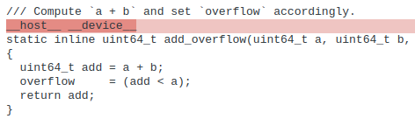
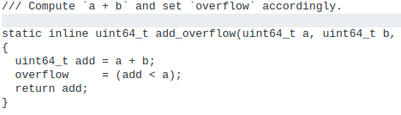
Converting the RanluxppDouble random generator
Removed CUDA annotations
Notes:
Removing the CUDA annotations with the help of dpct tool

Slide 33
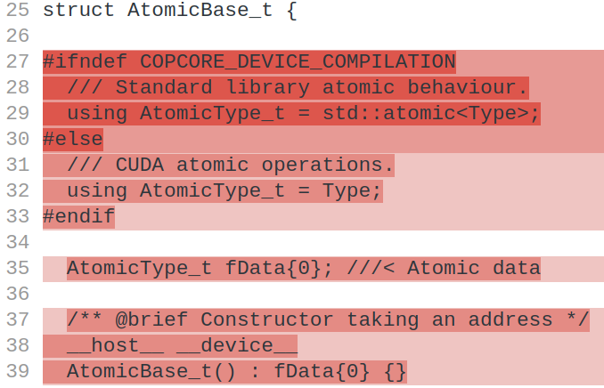
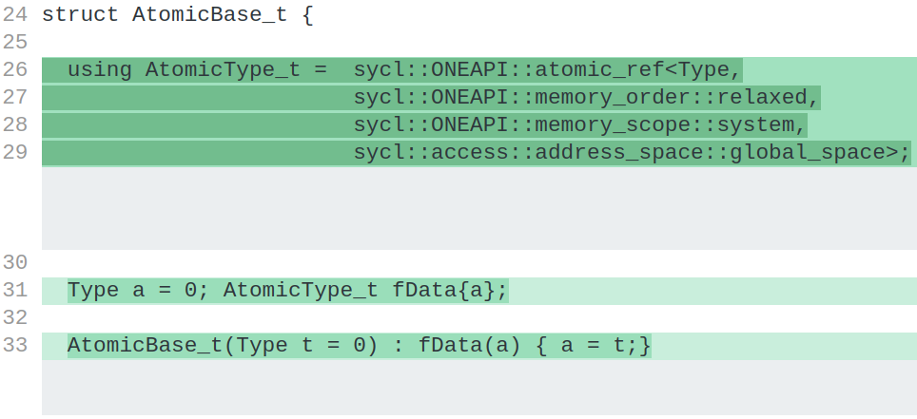
Atomic operations
Using sycl::ONEAPI::atomic_ref instead of std::atomic - full diff
Notes:
The sycl::atomic_ref class must be used to provide safe atomic access to the buffer or USM allocation from device code.

Slide 34
Pointer arithmetics
SYCL device code does not support function pointers in general
  Abstract classes were transformed in concrete classes
Notes:
SYCL device code, as defined by this specification, does not support virtual function calls, function pointers in general,

Slide 35
Virtual functions
SYCL device code does not support virtual function calls
ERROR:
LoopNavigator.h:42:17: error: SYCL kernel cannot call a virtual function
if (!vol->UnplacedContains(point)) return nullptr;
^
class VPlacedVolume:
Notes:
>> template
https://www.codeplay.com/portal/blogs/2019/07/12/enabling-polymorphism-in-sycl-using-the-cpp-idiom-crtp.html is slower (compile time) than switch statements because we know
SYCL device code, as defined by this specification, does not support virtual function calls

Slide 36
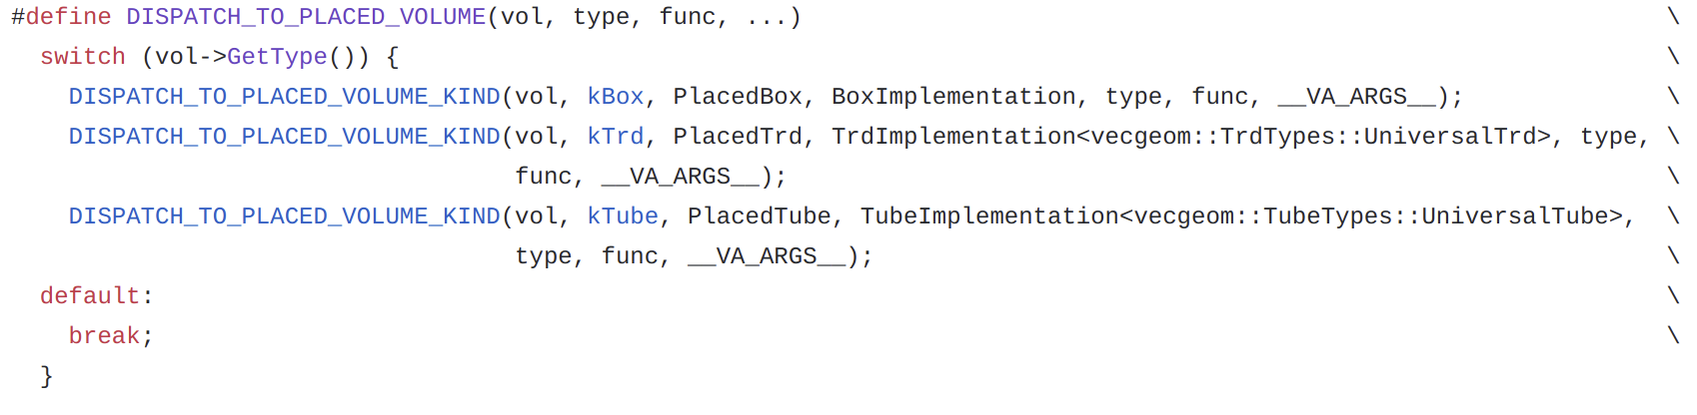
Virtual functions
UnplacedVolume.h:
Added a non-virtual dispatcher layer in AdepT

Slide 37
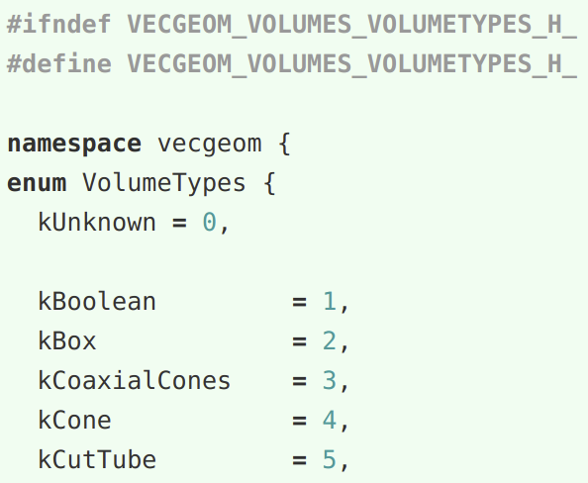
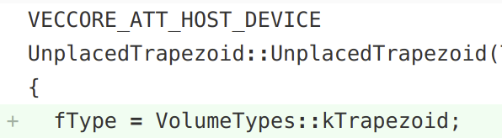
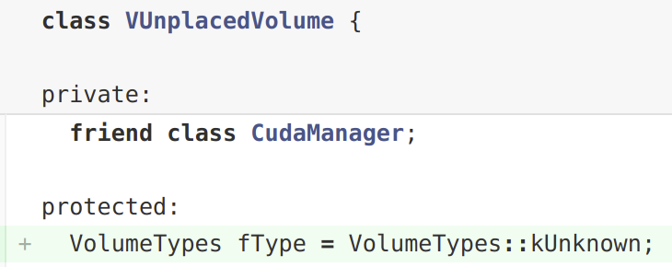
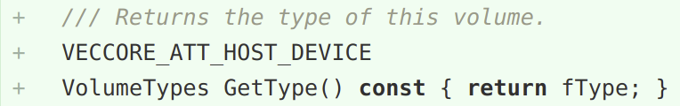
Virtual functions
VolumeTypes.h:
UnplacedTrapezoid.h:
constructor
UnplacedVolume.h:
Added support in VecGeom : VolumeTypes enum
Slower compared to virtual functions
jonas.hahnfeld@cern.ch

Slide 38
RUNLUX++
Generators with excellent quality and statistical properties:
MIXMAX (1991 / 2015)
RANLUX (1993 / 1994)
RANLUX: subtract-with-borrow generator with simple recursion
Waste intermediate states to decorrelate generated numbers
Luxury level: higher quality with longer computing time
RANLUX++: use the equivalent Linear Congruential Generator (LCG)
Avoid computing unneeded intermediate results, much higher quality “for free”
Advantage: fast skipping of numbers / “jumping” in generated sequence
Paper: A Portable High-Quality Random Number Generator for Lattice Field Theory Simulations
Slide from jonas.hahnfeld@cern.ch

