Slide 1
Application Optimization with
Cache-aware Roofline Model and Intel oneAPI tools
Aleksandar Ilic, Diogo Marques and Rafael Campos

Slide 2



















Hardware Heterogeneity
OPTIMIZATION
Application Diversity
goals
demands
Cache-aware Roofline Model

Slide 3

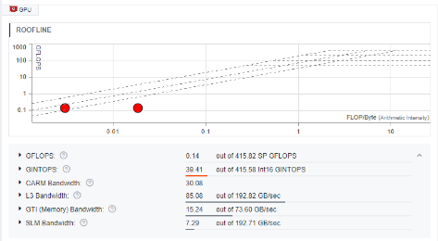
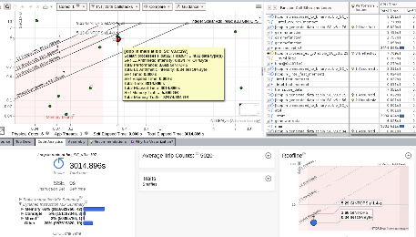

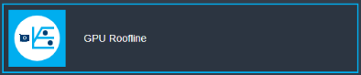
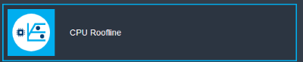
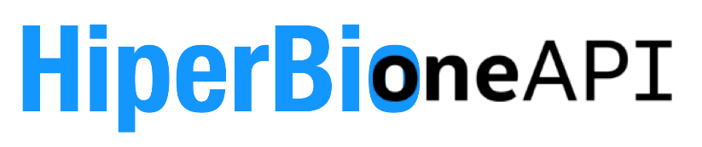
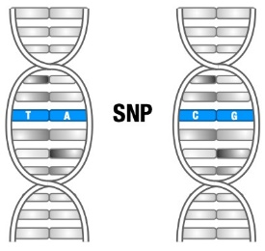





Boosting Epistasis Detection with oneAPI
GPU Optimization
CPU Optimization
Intel® Advisor
http://sparcity.eu
This project has received funding from the European High-Performance Computing Joint Undertaking under grant agreement No. 956213.

Slide 4
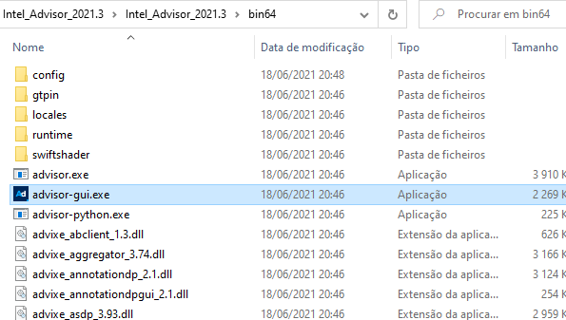
Download Intel Advisor
To run Advisor, unzip the Advisor compressed file, navigate
to the appropriate folder and run advisor-gui
Download Intel Advisor beta and the traces:
https://bit.ly/3d1N1tY
(available for Windows/MacOS/Linux)
Unzip the folders and you’re ready, no install required!
Disclaimer: This is a pre-release version of Advisor with beta quality, it may differ from the official release version. Thanks to Zakhar A. Matveev and Intel Advisor team for providing it.

Slide 5




PERFORMANCE
POWER
ENERGY-EFFICIENCY
CASE-STUDY
Outline

Slide 6




PERFORMANCE
POWER
ENERGY-EFFICIENCY
CASE-STUDY
Cache-aware Roofline Model
A. Ilic, F. Pratas and L. Sousa, “Cache-aware Roofline Model: Upgrading the Loft”, IEEE Computer Architecture Letters (2014)
D. Marques, A. Ilic, Z. Matveev and L. Sousa, “Application-driven Cache-Aware Roofline Model”, Elsevier FGCS (2020)

Slide 7
Roofline in a nutshell
Core
L1
L2
LLC
DRAM
Communication overlapped with computation
Max performance capped by peak compute throughput or available bandwidth (processor’s view)

Slide 8
What is bandwidth?
Core
L1
L2
LLC
DRAM
Cache-aware Roofline Model (CARM)¹: Bandwidth as seen by the core
                - Obtained via micro-benchmarking
Core
L1
L2
LLC
DRAM
Original Roofline Model (ORM)²: Bandwidth between memory levels
- Can be obtained from data-sheets
¹ A. Ilic, F. Pratas and L. Sousa, “Cache-aware Roofline Model: Upgrading the Loft”, IEEE Computer Architecture Letters (2014)
² S. Williams, A. Waterman, D. Patterson, "Roofline: An Insightful Visual Performance Model for Multicore Architectures”, Commun. ACM (2009)

Slide 9
Implications …
Core
L1
L2
LLC
DRAM
Cache-aware Roofline Model¹
                - One model, one arithmetic intensity
                - One application “point”
flops/s
flops/byte
Core
L1
L2
LLC
DRAM
Original Roofline Model²
                - Several models, several intensities
                - Several application “points”
flops/s
flops/s
flops/s
flops/s
flops/L1_byte
flops/L2_byte
flops/LLC_byte
flops/DRAM_byte
¹ A. Ilic, F. Pratas and L. Sousa, “Cache-aware Roofline Model: Upgrading the Loft”, IEEE Computer Architecture Letters (2014)
² S. Williams, A. Waterman, D. Patterson, "Roofline: An Insightful Visual Performance Model for Multicore Architectures”, Commun. ACM (2009)

Slide 10
Implications … bring cool features
Cache-aware Roofline Model
                - Shows absolute architecture maximums*
                (You can’t break them! Can your application exploit them?)
Peak performance (think: throughput of your ALUs)
L1
L2→Core
How to “plot” my code?
- CARM arithmetic intensity is exactly what you expect it to be!
L3→Core
DRAM→Core
code
Performance (flops/s)
...
float a = A[i];
float b = B[i];
float c = a*b;
C[i] = c;
...
your code
1 flop
12 bytes
AI = 1/12
log →
assembly
...
ld r1, mem[add1]
ld r2, mem[add2]
mul r3, r1, r2
st mem[add3], r3
...
log →
Arithmetic Intensity (flops/byte)
counters
...
MEM_RETIRED.LOADS
MEM_RETIRED.STORES
INST_RETIRED.FLOPS
CPU_CLK_CYCLES.ALL
...
A. Ilic, F. Pratas and L. Sousa, “Cache-aware Roofline Model: Upgrading the Loft”, IEEE Computer Architecture Letters (2014)
D. Marques, A. Ilic, Z. Matveev and L. Sousa, “Application-driven Cache-Aware Roofline Model”, Elsevier FGCS (2020)
                * We relaxed this requirement in our FCGS paper (2020)

Slide 11
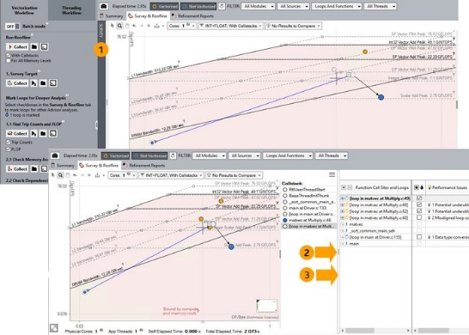
Implications … bring cool features
Cache-aware Roofline Model
                - Shows absolute architecture maximums
                (You can’t break them! Can your application exploit them?)
Peak performance (think: throughput of your ALUs)
L1
L2→Core
How to “plot” my code?
- CARM arithmetic intensity is exactly what you expect it to be!
L3→Core
DRAM→Core
Performance (flops/s)
Intel Advisor Roofline feature
- CARM is there since 2017
log →
log →
Arithmetic Intensity (flops/byte)
A. Ilic, F. Pratas and L. Sousa, “Cache-aware Roofline Model: Upgrading the Loft”, IEEE Computer Architecture Letters (2014)

Slide 12
Implications … bring cool features
Cache-aware Roofline Model
                - Shows absolute architecture maximums
                (You can’t break them! Can your application exploit them?)
Peak performance (think: throughput of your ALUs)
L1
L2→Core
How to “plot” my code?
- CARM arithmetic intensity is exactly what you expect it to be!
L3→Core
DRAM→Core
Performance (flops/s)
How to use CARM?
① Detect the boundness region
- What are my expected maximums?
- Provides first optimization hints
② Draw an imaginary vertical line
- What are my main bottlenecks? (observe intersected lines)
- Focus your optimization (aim at surpassing the line above)
③ Optimize your code: Break above roofs!
- You should move up (as your performance improves)
- Unless you restructure the code, or your compiler decides so…
memory
mixed
compute
Arithmetic Intensity (flops/byte)
memory bound
(improve access pattern, use of caches)
mixed
(all kinds of everything)
compute bound
(vectorize, parallelize…)
A. Ilic, F. Pratas and L. Sousa, “Cache-aware Roofline Model: Upgrading the Loft”, IEEE Computer Architecture Letters (2014)
D. Marques, et.al., “Performance analysis with Cache-aware Roofline Model in Intel Advisor”, HPCS (2017)

Slide 13
Implications … bring cool features
Cache-aware Roofline Model
                - Shows absolute architecture maximums
                (You can’t break them! Can your application exploit them?)
Peak performance (think: throughput of your ALUs)
L1
L2→Core
How to “plot” my code?
- CARM arithmetic intensity is exactly what you expect it to be!
L3→Core
DRAM→Core
Performance (flops/s)
How to use CARM?
① Detect the boundness region
- What are my expected maximums?
- Provides first optimization hints
② Draw an imaginary vertical line
- What are my main bottlenecks? (observe intersected lines)
- Focus your optimization (aim at surpassing the line above)
③ Optimize your code: Break above roofs!
- You should move up (as your performance improves)
- Unless you restructure the code, or your compiler decides so…
memory
mixed
compute
Arithmetic Intensity (flops/byte)
memory bound
(improve access pattern, use of caches)
mixed
(all kinds of everything)
compute bound
(vectorize, parallelize…)
A. Ilic, F. Pratas and L. Sousa, “Cache-aware Roofline Model: Upgrading the Loft”, IEEE Computer Architecture Letters (2014)
D. Marques, et.al., “Performance analysis with Cache-aware Roofline Model in Intel Advisor”, HPCS (2017)

Slide 14
Implications … bring cool features
Cache-aware Roofline Model
                - Shows absolute architecture maximums
                (You can’t break them! Can your application exploit them?)
Peak performance (think: throughput of your ALUs)
L1
L2→Core
How to “plot” my code?
- CARM arithmetic intensity is exactly what you expect it to be!
L3→Core
DRAM→Core
Performance (flops/s)
How to use CARM?
① Detect the boundness region
- What are my expected maximums?
- Provides first optimization hints
② Draw an imaginary vertical line
- What are my main bottlenecks? (observe intersected lines)
- Focus your optimization (aim at surpassing the line above)
③ Optimize your code: Break above roofs!
- You should move up (as your performance improves)
- Unless you restructure the code, or your compiler decides so…
memory
mixed
compute
Arithmetic Intensity (flops/byte)
memory bound
(improve access pattern, use of caches)
mixed
(all kinds of everything)
compute bound
(vectorize, parallelize…)
A. Ilic, F. Pratas and L. Sousa, “Cache-aware Roofline Model: Upgrading the Loft”, IEEE Computer Architecture Letters (2014)
D. Marques, et.al., “Performance analysis with Cache-aware Roofline Model in Intel Advisor”, HPCS (2017)

Slide 15
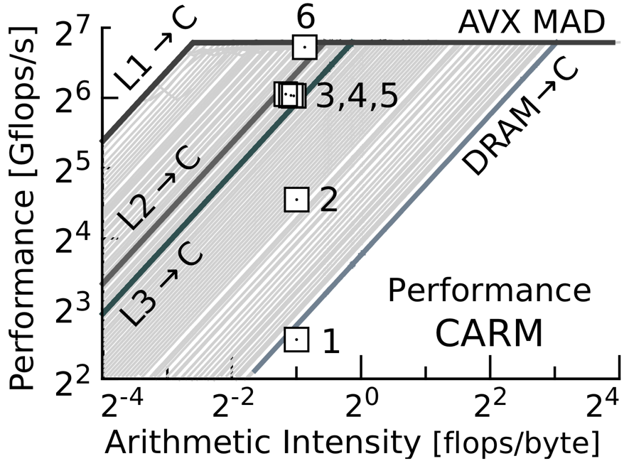
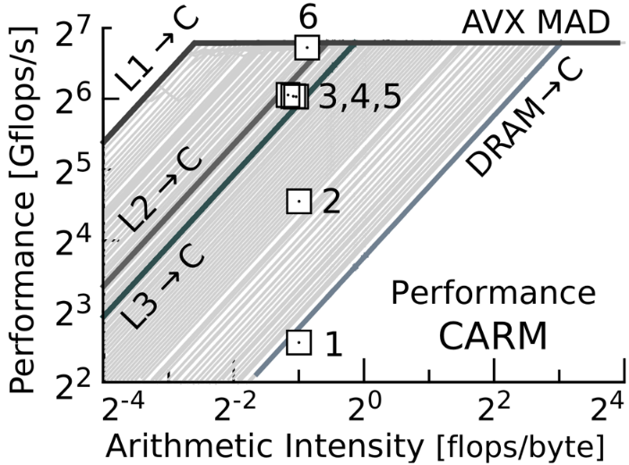


Matrix Multiplication
All codes AVX vectorized!*
[1]
Basic implementation (row major)
A
x
B
=
C
2⁷
[2]
Transposed B (improved mem. access)
2⁵
A
x
B
=
C
Performance (Gflops/s)
[3,4,5]
Cache blocking: L3, L2, L1
2³
A
x
B
=
C
2⁻²
2⁰
2²
Arithmetic Intensity (flops/byte)
[6]
Intel MKL
x
=
* A. Ilic, F. Pratas and L. Sousa, “Cache-aware Roofline Model: Upgrading the Loft”, IEEE Computer Architecture Letters (2014)
* A. Ilic, F. Pratas and L. Sousa, “Beyond the Roofline: Cache-Aware Power and Energy-Efficiency Modeling for Multi-Cores”, IEEE Trans. on Computers (2017)

Slide 16

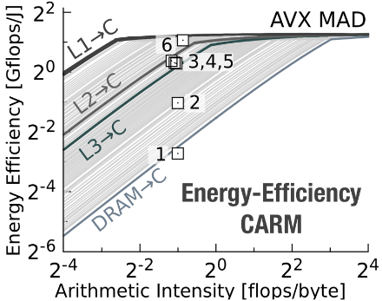
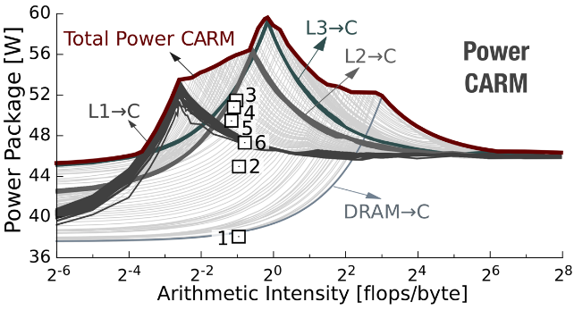
Matrix Multiplication
All codes AVX vectorized!*
[1]
Basic implementation (row major)
A
x
B
=
C
Performance
CARM
[2]
Transposed B (improved mem. access)
A
x
B
=
C
[3,4,5]
Cache blocking: L3, L2, L1
A
x
B
=
C
[6]
Intel MKL
x
=
* A. Ilic, F. Pratas and L. Sousa, “Cache-aware Roofline Model: Upgrading the Loft”, IEEE Computer Architecture Letters (2014)
* A. Ilic, F. Pratas and L. Sousa, “Beyond the Roofline: Cache-Aware Power and Energy-Efficiency Modeling for Multi-Cores”, IEEE Trans. on Computers (2017)

Slide 17
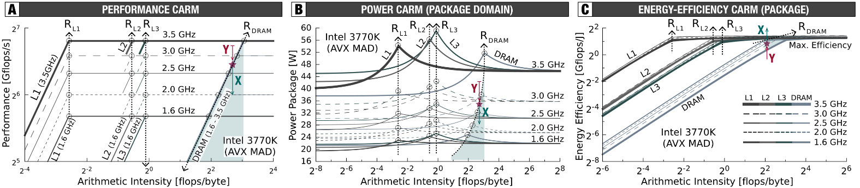
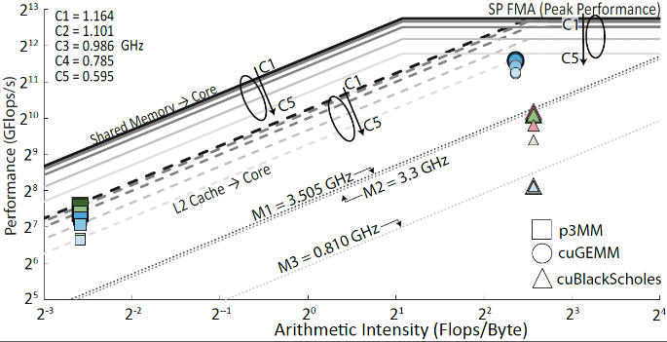
Cache-aware Roofline Model: Extensions
CARM-based DVFS analysis
GPU CARM: Performance, Power, DVFS
NUMA CARM: Multi-socket, KNL
A. Ilic, F. Pratas, L. Sousa, “Beyond the Roofline: Cache-Aware Power and Energy-Efficiency Modeling for Multi-Cores”, IEEE Trans. on Computers (2017)
A. Lopes, F. Pratas, L. Sousa, A. Ilic, “Exploring GPU performance, power and energy-efficiency bounds with Cache-aware Roofline Modeling”, ISPASS (2017)
N. Denoyelle, B. Goglin, A. Ilic, E. Jeannot, L. Sousa, “Modeling Non-Uniform Memory Access on Large Compute Nodes with the Cache-Aware Roofline Model”, IEEE TPDS (2018)

Slide 18
Download Intel Advisor
To run Advisor, unzip the Advisor compressed file, navigate
to the appropriate folder and run advisor-gui
Download Intel Advisor beta and the traces:
https://bit.ly/3d1N1tY
(available for Windows/MacOS/Linux)
Unzip the folders and you’re ready, no install required!
Disclaimer: This is a pre-release version of Advisor with beta quality, it may differ from the official release version. Thanks to Zakhar A. Matveev and Intel Advisor team for providing it.

Slide 19



PERFORMANCE
POWER
ENERGY-EFFICIENCY
CASE-STUDY
Epistasis Detection
R. Nobre, A. Ilic, S. Santander-Jiménez, L. Sousa, “Exploring the Binary Precision Capabilities of Tensor Cores for Epistasis Detection”, IPDPS (2020)
R. Campos, D. Marques, S. Santander-Jiménez, L. Sousa, A. Ilic, “Heterogeneous CPU+ iGPU Processing for Efficient Epistasis Detection”, EuroPar (2020)

Slide 20

Epistasis in a nutshell
Some SNP interactions may cause life-threating diseases (e.g., Alzheimer, breast cancer)
Discovering which and how many is important, but challenging task!

Slide 21
Short Bio Recap: Codifying your genotype
Allele - A1
Allele - A2
Genotype
A1
A2
0
Homozygous Major
1
Heterozygous
2
Homozygous Minor
dominant allele
recessive allele

Slide 22
Binarizing your genotype
Allele - A1
Allele - A2
SNP X
P0
Genotype
A1
A2
X0
0
0
Homozygous Major
X1
1
1
Heterozygous
X2
0
2
Homozygous Minor
phenotype
0
dominant allele
recessive allele
Think: Patient 0 (P0) with genotype 1 does not have disease (control)

Slide 23
Binarizing your genotype
Allele - A1
Allele - A2
SNP X
P0
P1
Genotype
A1
A2
X0
0
0
0
Homozygous Major
X1
1
0
1
Heterozygous
X2
0
1
2
Homozygous Minor
phenotype
0
1
dominant allele
recessive allele
Think: Patient 1 (P1) with genotype 2 has disease (case)

Slide 24
Dataset structure
N Samples (Patients)
SNP X
P0
P1
P2
P3
P4
P5
...
PN
SNP 0
X0
0
0
0
1
0
0
…
1
X1
1
0
1
0
0
1
…
0
M SNPs
X0
X1
SNP X
X2
0
1
0
0
1
0
…
0
X2
. . .
phenotype
0
1
1
1
0
0
…
1
SNP M-1
phenotype
Dataset structure
Our dataset: 10 048 SNPs x 104 448 samples

Slide 25
2-way Epistasis Detection: Pair-wise interaction
Pair-wise interaction: SNPs (X,Y)
N Samples (Patients)
frequency table
Search space: All SNP combinations
X1
Y0
X2
Y2
(0,1)
(0,2)
(0,3)
(0,4)
(…)
(0,M-1)
00
01
02
10
11
12
20
21
22
genotype
combination
(1,2)
(1,3)
(1,4)
(…)
(1,M-1)
ph.type: 0
M SNPs
X0
SNP X
(2,3)
(2,4)
(…)
(2,M-1)
X1
ph.type: 1
X2
(3,4)
(…)
(3,M-1)
M(M-1)/2
combinations
popcnt
popcnt
. . .
(…)
phenotype
and
phenotype
not
and
Y0
(…)
(M-2,M-1)
Y1
SNP Y
X1
Y0
X2
Y2
Y2
phenotype
Dataset structure
Our dataset: 10 048 SNPs x 104 448 samples
Our dataset: 50 476 128 combinations
Each frequency table evaluated with Bayesian K2 score
Epistasis: Minimum K2 score among all combinations!
R. Nobre, A. Ilic, S. Santander-Jiménez, L. Sousa, “Exploring the Binary Precision Capabilities of Tensor Cores for Epistasis Detection”, IPDPS (2020)
R. Campos, D. Marques, S. Santander-Jiménez, L. Sousa, A. Ilic, “Heterogeneous CPU+ iGPU Processing for Efficient Epistasis Detection”, EuroPar (2020)
Notes:
0

Slide 26
Epistasis Detection: GPU Optimization
Results obtained with Intel® Advisor | Platform: Intel® HD Graphics P630 GPU (@1.15 GHz)
Notes:
0

Slide 27
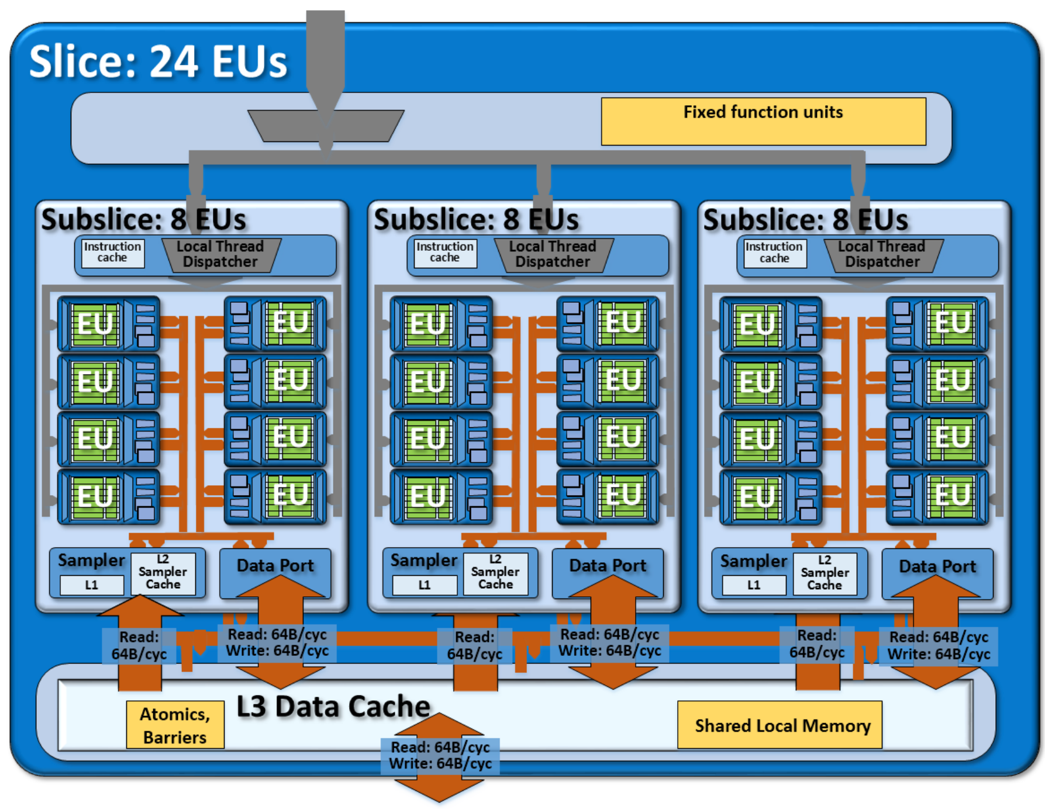
GPU architecture
GPU Optimization
LLC/DRAM
Intel Corporation, “The Compute Architecture of Intel® Processor Graphics Gen9”
Notes:
0

Slide 28
GPU architecture
GPU Optimization
Execution
Unit
Subslice
LLC/DRAM
Intel Corporation, “The Compute Architecture of Intel® Processor Graphics Gen9”
Notes:
0

Slide 29
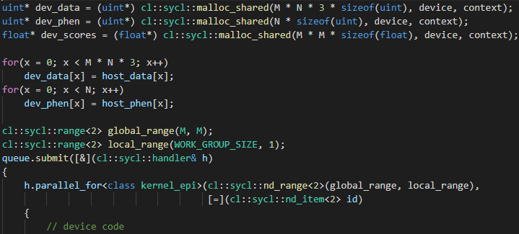
DPC++ setup
GPU Optimization
DPC++ setup
Host code
Create USM buffers
Transfer data from host to device
Launch kernel to execute on device
(0,1)
(0,2)
(0,3)
(0,4)
(…)
(0,M-1)
The kernel is launched for M*M
work-items
(1,1)
(1,2)
(1,3)
(1,4)
(…)
(1,M-1)
(…)
(2,2)
(2,3)
(2,4)
(…)
(2,M-1)
(…)
(3,3)
(3,4)
(…)
(3,M-1)
Work-items without a valid combination
will not do work
(…)
(4,4)
(…)
(…)
(…)
(M-2,M-1)
Notes:
0

Slide 30
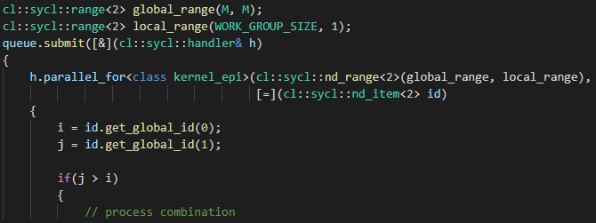
DPC++ setup
GPU Optimization
DPC++ setup
Device code
Kernel defined as lambda function
Obtain SNPs from work-item index
(0,1)
(0,2)
(0,3)
(0,4)
(…)
(0,M-1)
The kernel is launched for M*M
work-items
(1,1)
(1,2)
(1,3)
(1,4)
(…)
(1,M-1)
(…)
(2,2)
(2,3)
(2,4)
(…)
(2,M-1)
(…)
(3,3)
(3,4)
(…)
(3,M-1)
Work-items without a valid combination
will not do work
(…)
(4,4)
(…)
(…)
(…)
(M-2,M-1)
Notes:
0

Slide 31
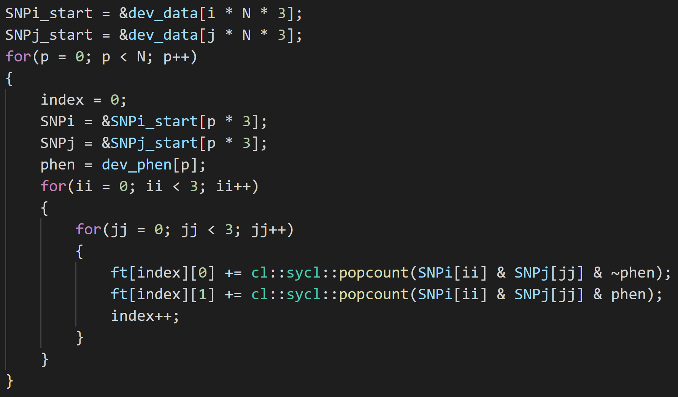
DPC++ implementation
GPU Optimization
Three Genotypes + Phenotype
popcnt
not
and
Device code
Pair-wise interaction: SNPs (i,j)
frequency table
i1
j0
i2
j2
00
01
02
10
11
12
20
21
22
genotype
combination
ph.type: 0
ph.type: 1
popcnt
popcnt
phenotype
and
phenotype
not
and
i1
j0
i2
j2
The frequency table is filled for SNPs i and j by going through
all samples, disposed in columns
Notes:
0

Slide 32
DPC++ implementation
GPU Optimization
Three Genotypes + Phenotype
popcnt
not
and
Device code
p advances column-wise
The freq. table is filled using 3 genotypes and phenotype
The frequency table is filled for SNPs i and j by going through
all samples, disposed in columns
Notes:
0

Slide 33
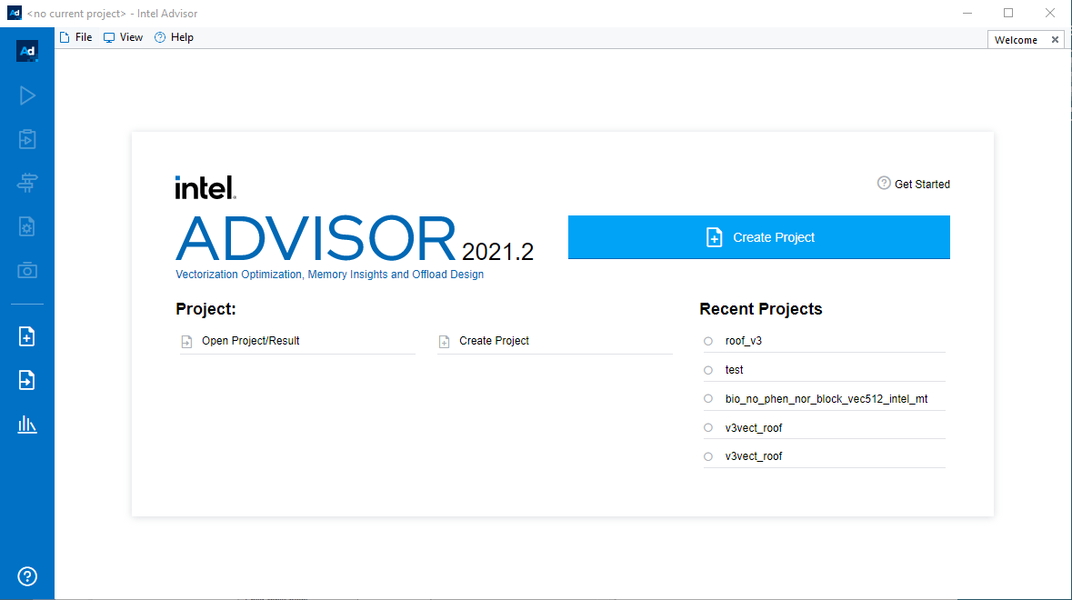
Opening Advisor Result
GPU Optimization
Three Genotypes + Phenotype
popcnt
not
and
Open Project
Alternative: File > Open > Project
Open the file in traces/v1/v1.advixeproj
Notes:
0

Slide 34
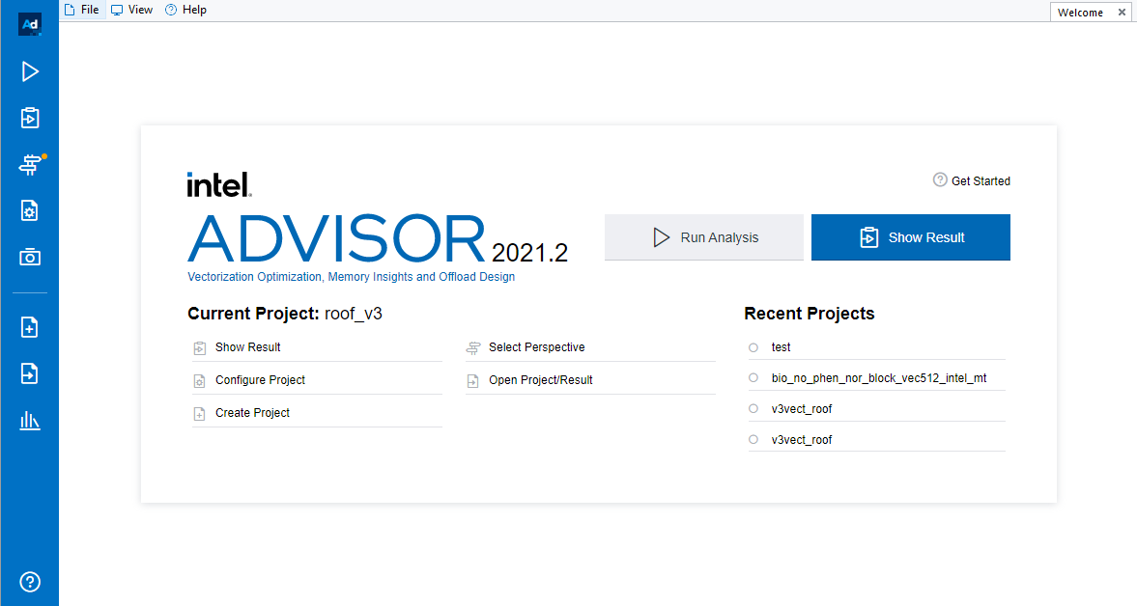
Opening Advisor Result
GPU Optimization
Three Genotypes + Phenotype
popcnt
not
and
Perspective Selector
Notes:
0

Slide 35
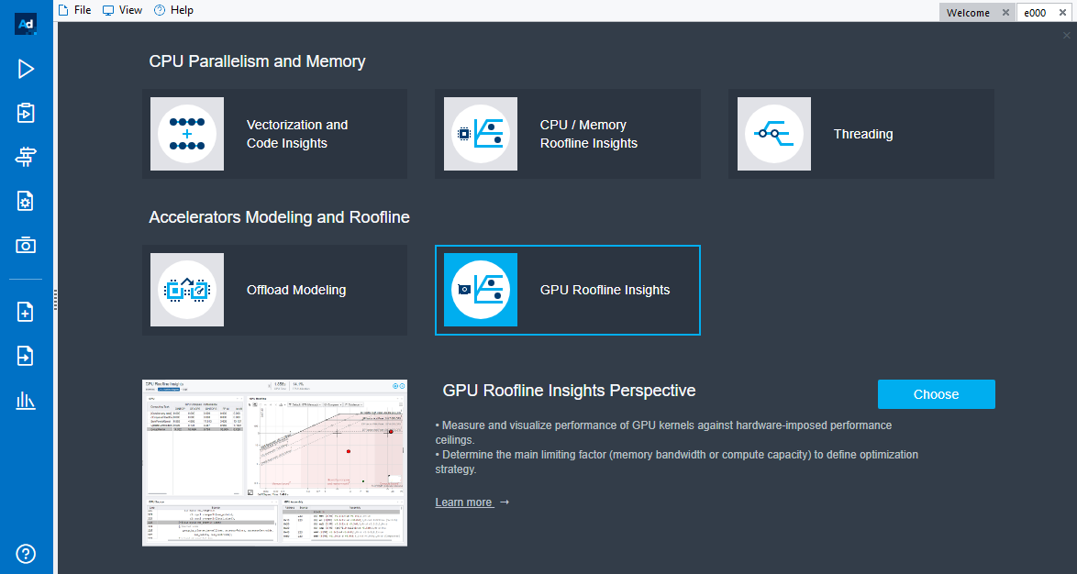
Opening Advisor Result
GPU Optimization
Three Genotypes + Phenotype
Choose GPU Roofline Insights
popcnt
not
and
Double Click
Notes:
0

Slide 36
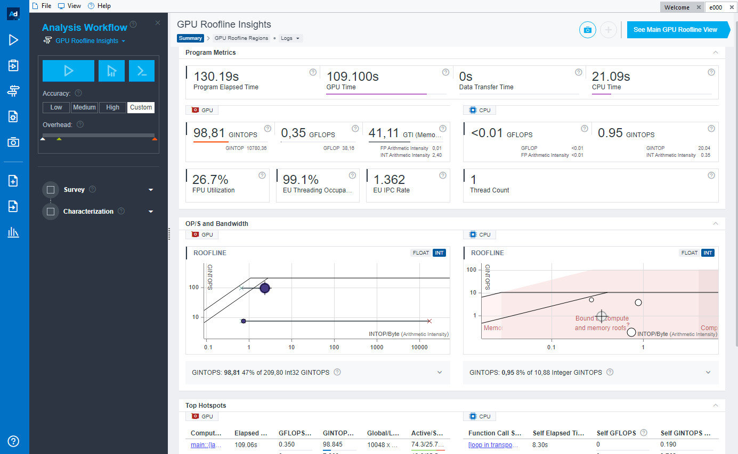
GPU Roofline in Advisor
GPU Optimization
Three Genotypes + Phenotype
Summary View:
popcnt
not
and
Notes:
0

Slide 37
GPU Roofline in Advisor
GPU Optimization
Three Genotypes + Phenotype
Summary View:
popcnt
not
and
General Metrics
Notes:
0

Slide 38
GPU Roofline in Advisor
GPU Optimization
Three Genotypes + Phenotype
Summary View:
popcnt
not
and
General Metrics
GPU Roofline
CPU Roofline
Notes:
0

Slide 39
GPU Roofline in Advisor
GPU Optimization
Three Genotypes + Phenotype
Summary View:
popcnt
not
and
General Metrics
GPU Roofline
CPU Roofline
Main Hotspots
Notes:
0

Slide 40
GPU Roofline in Advisor
GPU Optimization
Three Genotypes + Phenotype
Summary View:
Close this panel
popcnt
not
and
Notes:
0

Slide 41
GPU Roofline in Advisor
GPU Optimization
Three Genotypes + Phenotype
Summary View:
Close this panel
Click to open Main GPU Roofline View
popcnt
not
and
Notes:
0

Slide 42
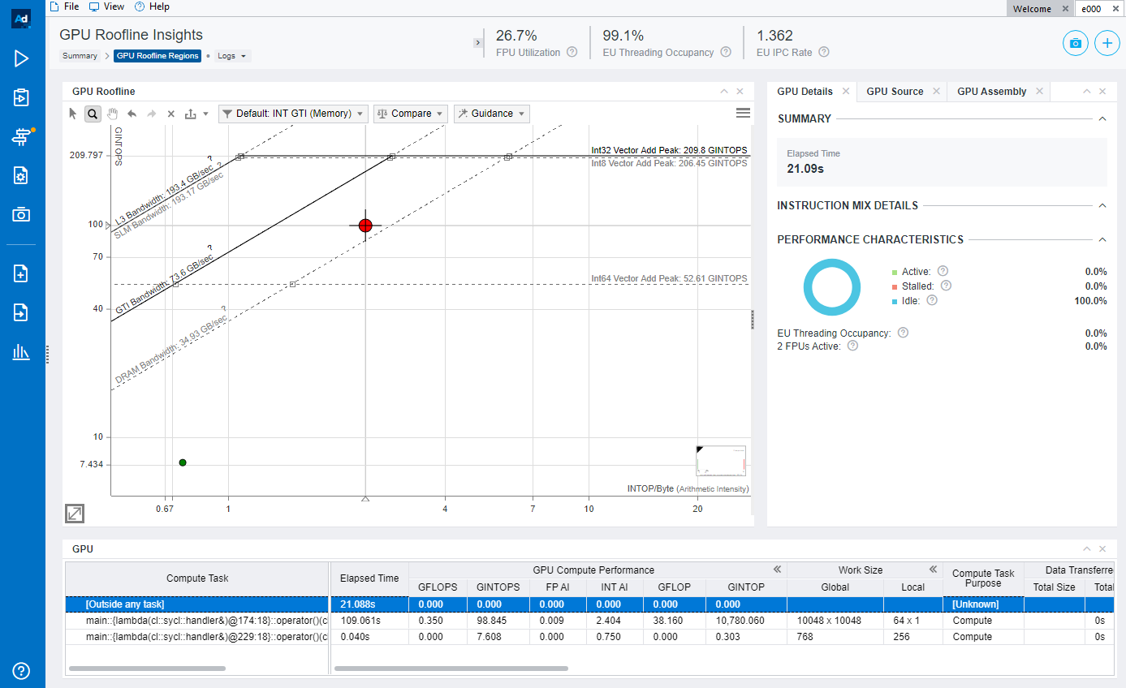
Advisor in action…
GPU Optimization
Three Genotypes + Phenotype
popcnt
GPU Roofline
not
and
Notes:
0

Slide 43
Advisor in action…
GPU Optimization
Three Genotypes + Phenotype
popcnt
GPU Roofline
not
and
Click on dot
Notes:
0

Slide 44
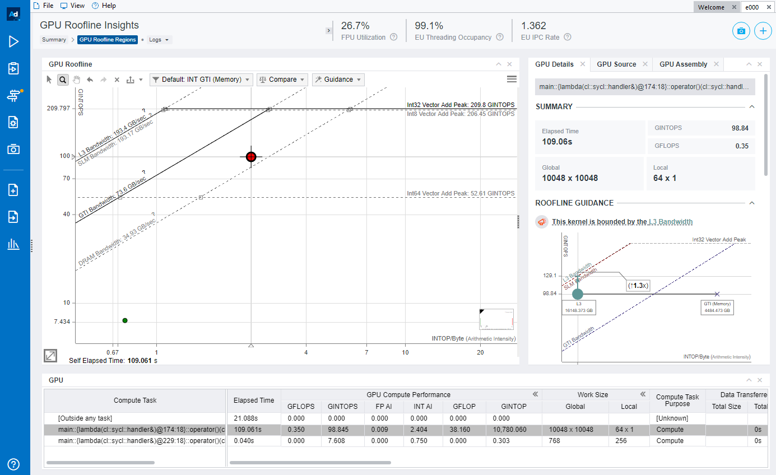
Advisor in action…
GPU Optimization
Three Genotypes + Phenotype
popcnt
GPU Roofline
not
and
Notes:
0

Slide 45
Advisor in action…
GPU Optimization
Three Genotypes + Phenotype
popcnt
GPU Roofline
Kernel Details
not
and
Notes:
0

Slide 46
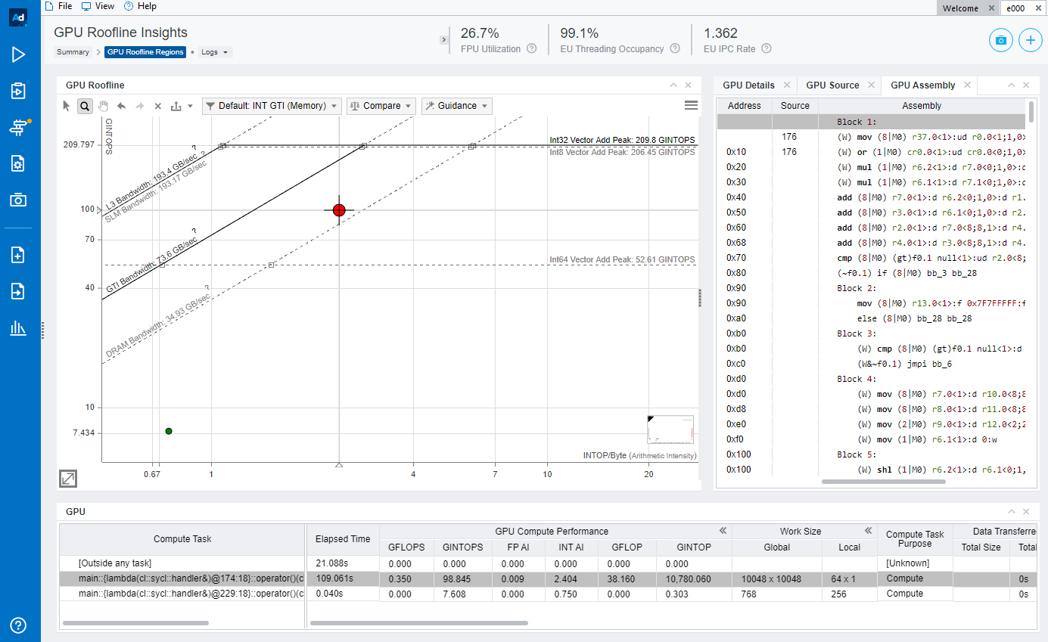
Advisor in action…
GPU Optimization
Three Genotypes + Phenotype
popcnt
GPU Roofline
Kernel Assembly
not
and
Notes:
0

Slide 47
Advisor in action…
GPU Optimization
Three Genotypes + Phenotype
popcnt
GPU Roofline
Kernel Assembly
not
and
Detailed information on all GPU Kernels
Notes:
0

Slide 48
Advisor in action…
GPU Optimization
Three Genotypes + Phenotype
Close this tab
popcnt
not
and
Close this tab
Notes:
0

Slide 49
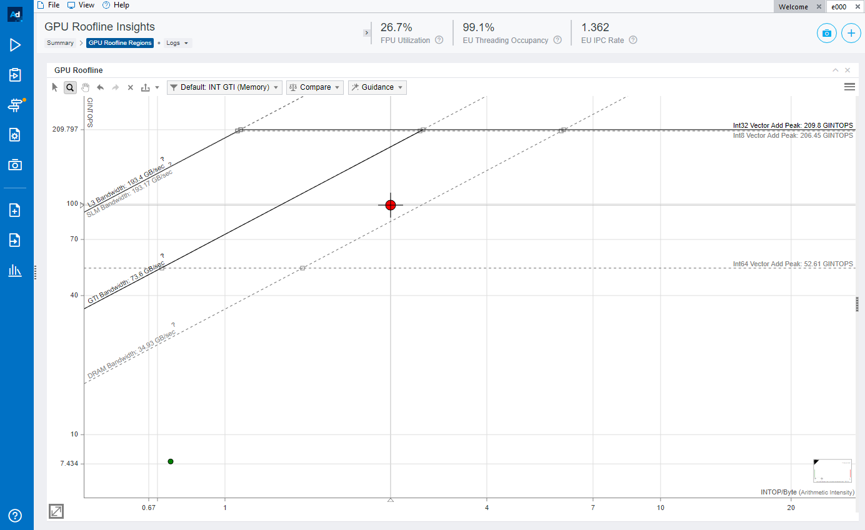
Advisor in action…
GPU Optimization
Three Genotypes + Phenotype
popcnt
not
and
Click here to select CARM AI
Notes:
0

Slide 50
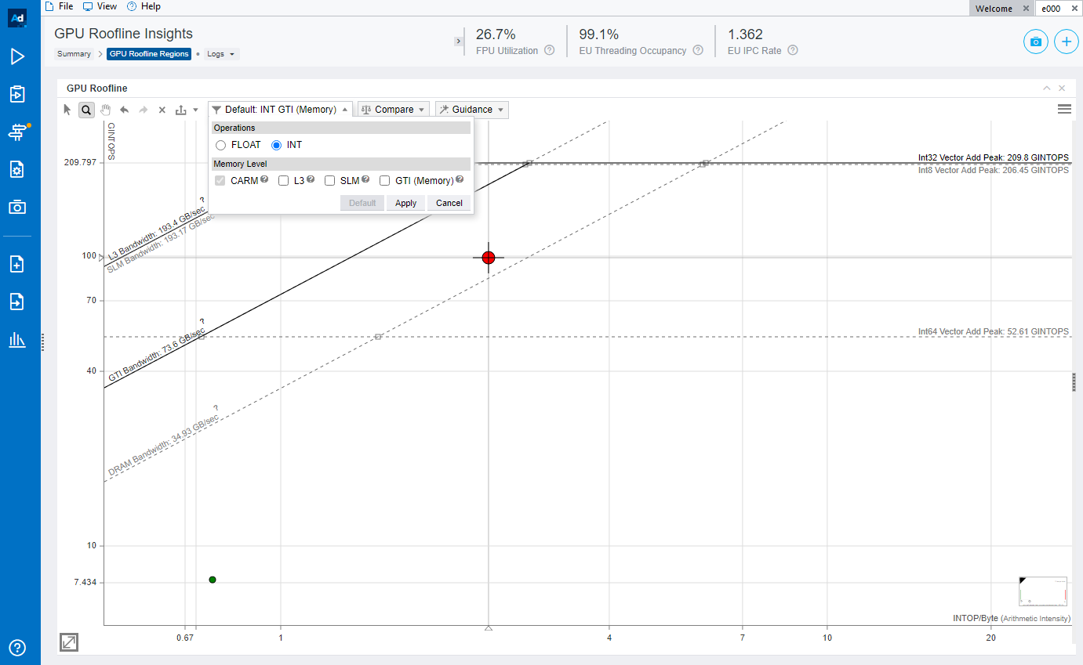
Advisor in action…
GPU Optimization
Three Genotypes + Phenotype
popcnt
not
and
Select CARM
Remove GTI
Notes:
0

Slide 51
Advisor in action…
GPU Optimization
Three Genotypes + Phenotype
popcnt
not
and
Select CARM
Remove GTI
Click Apply
Notes:
0

Slide 52
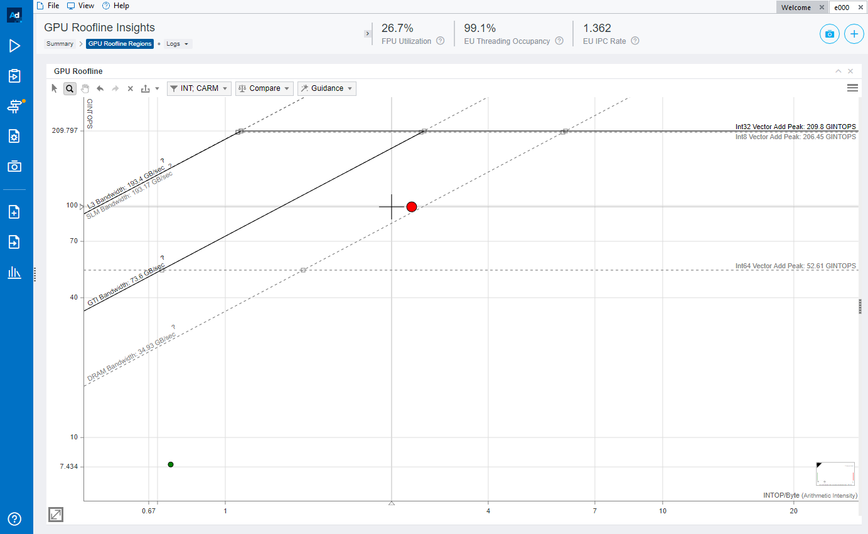
Advisor in action…
GPU Optimization
Three Genotypes + Phenotype
popcnt
not
and
Kernel CARM AI
Notes:
0

Slide 53
Advisor in action…
GPU Optimization
Three Genotypes + Phenotype
popcnt
not
and
Customize Roofline
Notes:
0

Slide 54
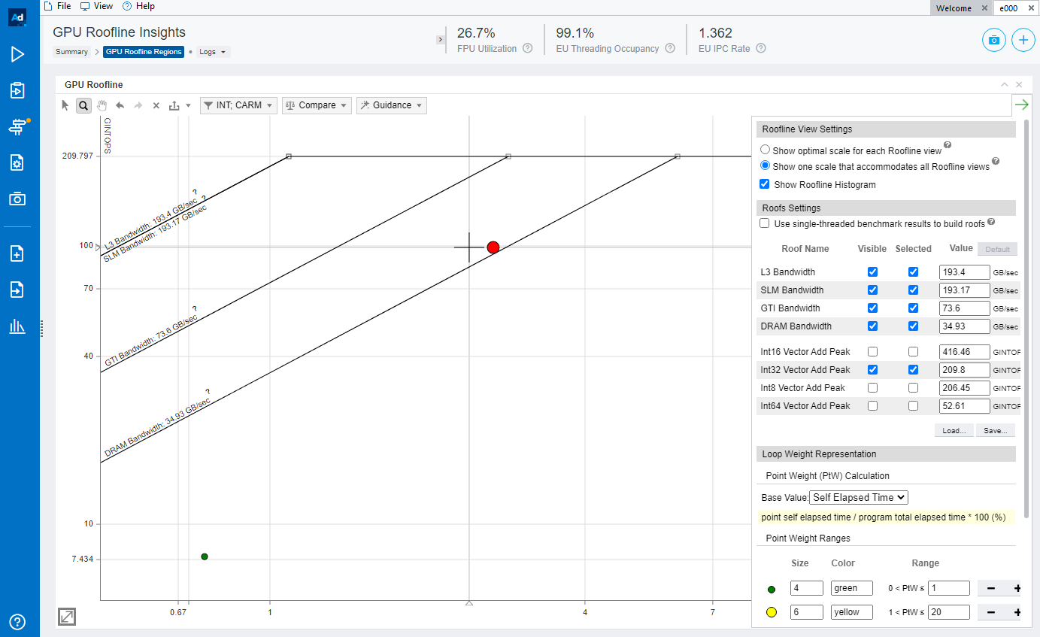
Advisor in action…
GPU Optimization
Three Genotypes + Phenotype
popcnt
not
and
Select only used roofs
Notes:
0

Slide 55
Advisor in action…
GPU Optimization
Three Genotypes + Phenotype
popcnt
not
and
Click here after roof selection
Notes:
0

Slide 56
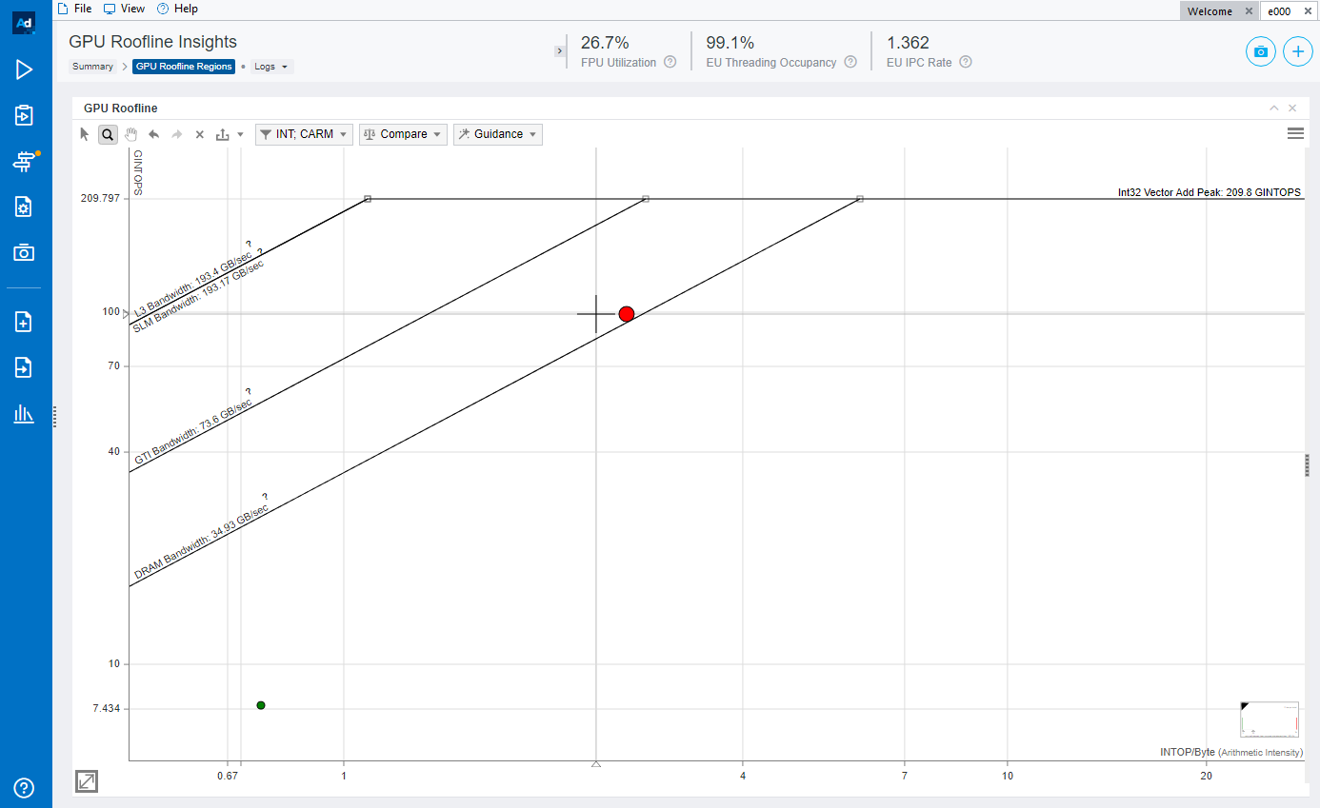
Advisor in action…
GPU Optimization
Three Genotypes + Phenotype
popcnt
not
and
Leave cursor on top of kernel to get more information
Notes:
0

Slide 57
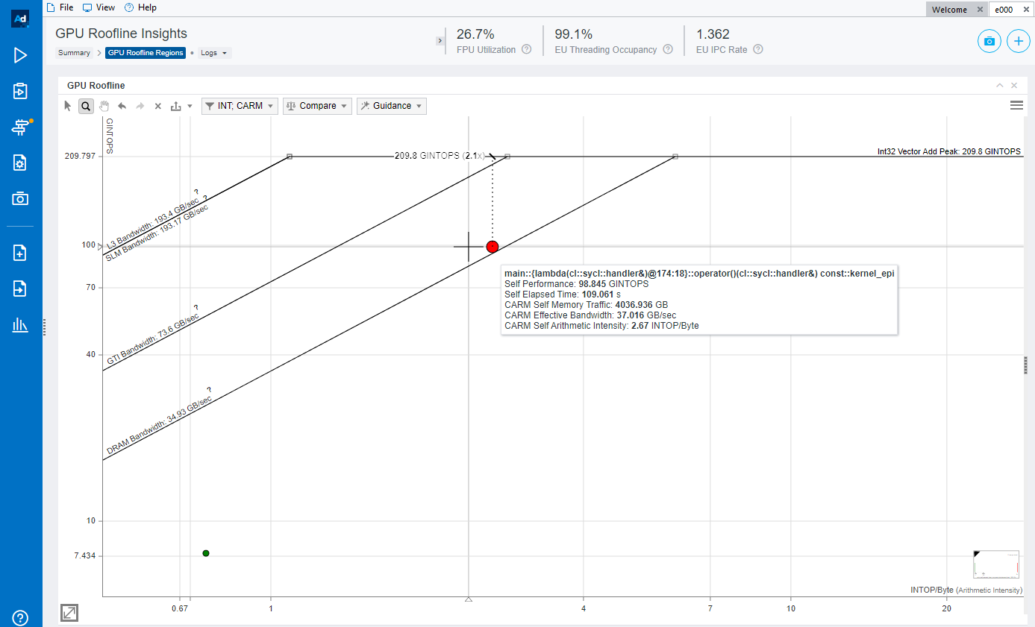
Advisor in action…
GPU Optimization
Three Genotypes + Phenotype
popcnt
not
and
Performance needs improvement!
The application is memory bound – let’s restructure
Notes:
0

Slide 58
Restructuring our algorithm…
GPU Optimization
Three Genotypes + Phenotype
popcnt
not
and
Pair-wise interaction: SNPs (i,j)
Two Genotypes, No Phenotype
Controls
Cases
frequency table
popcnt
00
01
02
10
11
12
20
21
22
reconstructed
combinations
and
M SNPs
i0₀
i0₁
SNP i
nor
nor
ph: 0
i1₀
i1₁
ph: 1
. . .
. . .
popcnt
popcnt
and
and
ph.type: 0
ph.type: 1
i2₀
j2₀
i1₁
j0₁
nor
nor
“New” Dataset structure
(removed: phenotype and genotype 2)
i0₀
i1₀
j0₀
j1₀
Reducing memory transfers!
R. Nobre, A. Ilic, S. Santander-Jiménez, L. Sousa, “Exploring the Binary Precision Capabilities of Tensor Cores for Epistasis Detection”, IPDPS (2020)
Notes:
0

Slide 59
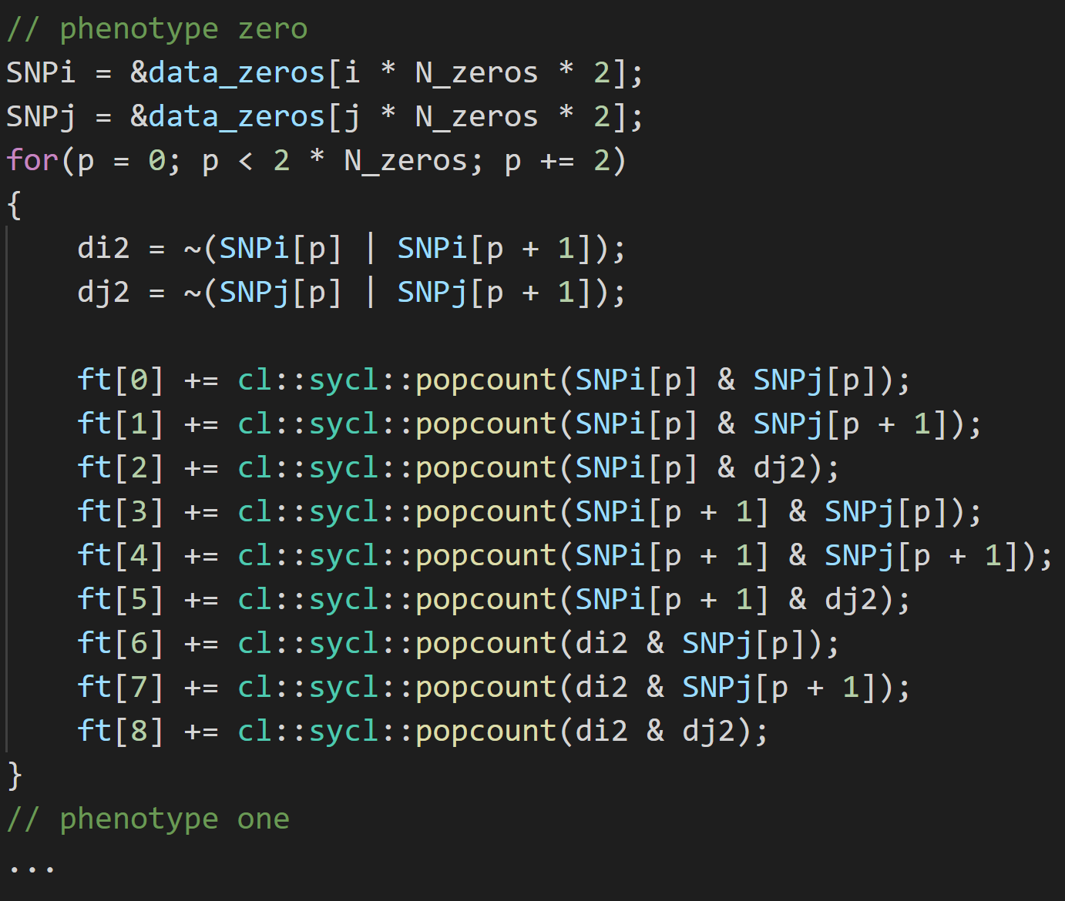
DPC++ implementation
GPU Optimization
Three Genotypes + Phenotype
popcnt
Device code
not
and
Pair-wise interaction: SNPs (i,j)
Two Genotypes, No Phenotype
frequency table
popcnt
00
01
02
10
11
12
20
21
22
reconstructed
combinations
and
ph: 0
nor
nor
ph: 1
popcnt
popcnt
and
and
i2₀
j2₀
i1₁
j0₁
nor
nor
i0₀
i1₀
j0₀
j1₀
The frequency table is filled for SNPs i and j is filled separately
for each phenotype
R. Nobre, A. Ilic, S. Santander-Jiménez, L. Sousa, “Exploring the Binary Precision Capabilities of Tensor Cores for Epistasis Detection”, IPDPS (2020)
Notes:
0

Slide 60
DPC++ implementation
GPU Optimization
Three Genotypes + Phenotype
popcnt
Device code
not
and
Two Genotypes, No Phenotype
The data set is iterated by columns
popcnt
The 3rd genotype is computed
and
nor
nor
The frequency table is filled using 2 genotypes
The frequency table is filled for SNPs i and j is filled separately
for each phenotype
R. Nobre, A. Ilic, S. Santander-Jiménez, L. Sousa, “Exploring the Binary Precision Capabilities of Tensor Cores for Epistasis Detection”, IPDPS (2020)
Notes:
0

Slide 61
Advisor in action…
GPU Optimization
Three Genotypes + Phenotype
popcnt
not
and
Two Genotypes, No Phenotype
Two Genotypes, No Phenotype
Add Trace to compare
popcnt
and
nor
nor
Notes:
0

Slide 62
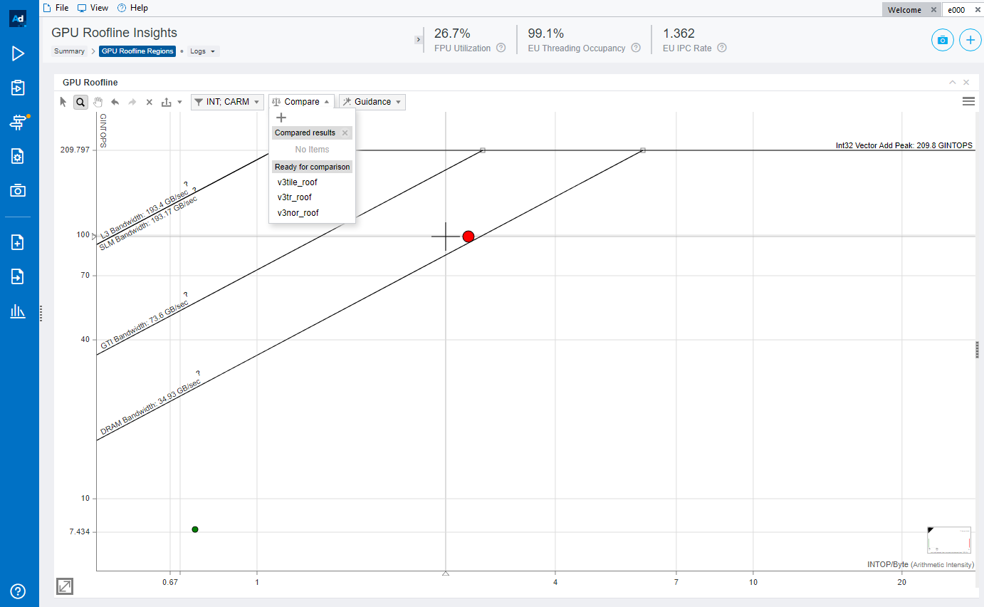
Advisor in action…
GPU Optimization
Three Genotypes + Phenotype
popcnt
not
and
Two Genotypes, No Phenotype
Click on + sign
Two Genotypes, No Phenotype
Select the file traces/v2.advixeexpz
popcnt
and
nor
nor
Notes:
0

Slide 63
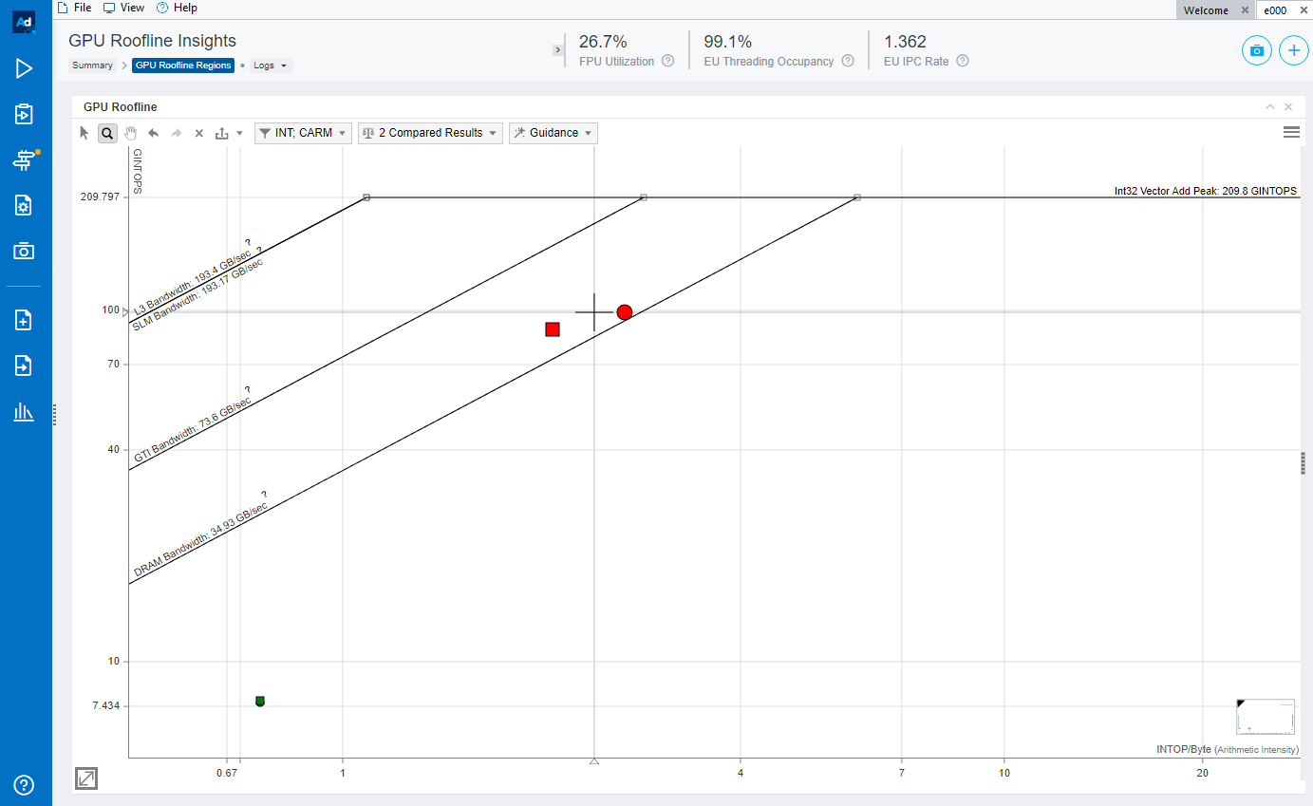
Advisor in action…
GPU Optimization
Three Genotypes + Phenotype
popcnt
not
and
Two Genotypes, No Phenotype
Two Genotypes, No Phenotype
popcnt
and
nor
nor
V1
V2
Notes:
0

Slide 64
Advisor in action…
GPU Optimization
Three Genotypes + Phenotype
popcnt
not
and
Two Genotypes, No Phenotype
Two Genotypes, No Phenotype
popcnt
and
nor
nor
Changing the algorithm moved us to the left!
Performance is worse!
Notes:
0

Slide 65
Advisor in action…
GPU Optimization
Three Genotypes + Phenotype
popcnt
not
and
Two Genotypes, No Phenotype
Two Genotypes, No Phenotype
popcnt
and
nor
nor
Speedup: 1.8x
ALUops: 2.0x decrease
Bytes: 1.5x decrease
Arith. Intensity: 1.3x decrease
Not so good thing!
Your speedup better be pretty high to surpass
performance of previous version (think: IPC)!
Not so good thing!
But we do have better algorithm
(speedup and performance improvement)
Notes:
0

Slide 66
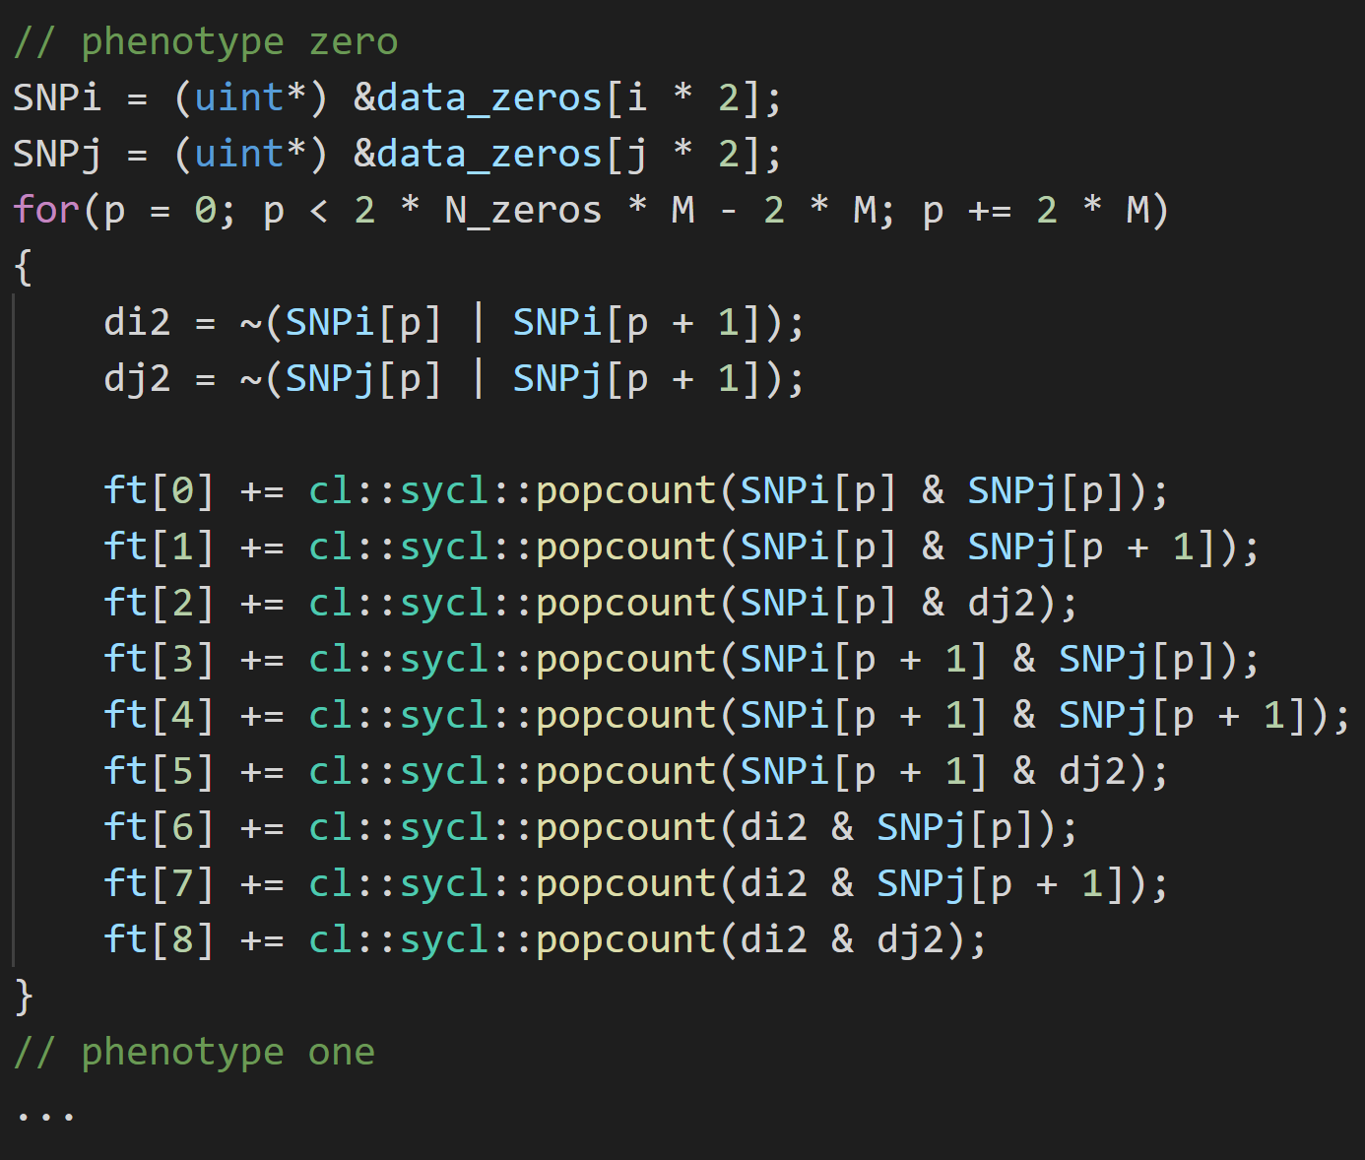

Let’s continue optimizing…
GPU Optimization
Three Genotypes + Phenotype
Device code
popcnt
not
and
Two Genotypes, No Phenotype
Controls
Cases
popcnt
and
nor
nor
N0 Samples
N1 Samples
. . .
. . .
Transposed Dataset
popcnt
ph.type: 0
ph.type: 1
and
nor
nor
Transposed Dataset
(inverted SNPs and samples)
Improving memory accesses by dataset transposition
Coalescing of memory accesses by the work-items
Notes:
0

Slide 67
Let’s continue optimizing…
GPU Optimization
Three Genotypes + Phenotype
Device code
popcnt
not
and
The data set is iterated by rows of size 2*M
Two Genotypes, No Phenotype
popcnt
The 3rd genotype is computed
and
nor
nor
Transposed Dataset
The frequency table is filled using 2 genotypes
popcnt
and
nor
nor
Improving memory accesses by dataset transposition
Coalescing of memory accesses by the work-items
Notes:
0

Slide 68
Advisor in action…
GPU Optimization
Three Genotypes + Phenotype
popcnt
not
and
Two Genotypes, No Phenotype
Add another trace to compare
Two Genotypes, No Phenotype
Select the file traces/v3.advixeexpz
popcnt
and
nor
nor
Transposed Dataset
popcnt
and
nor
nor
Notes:
0

Slide 69
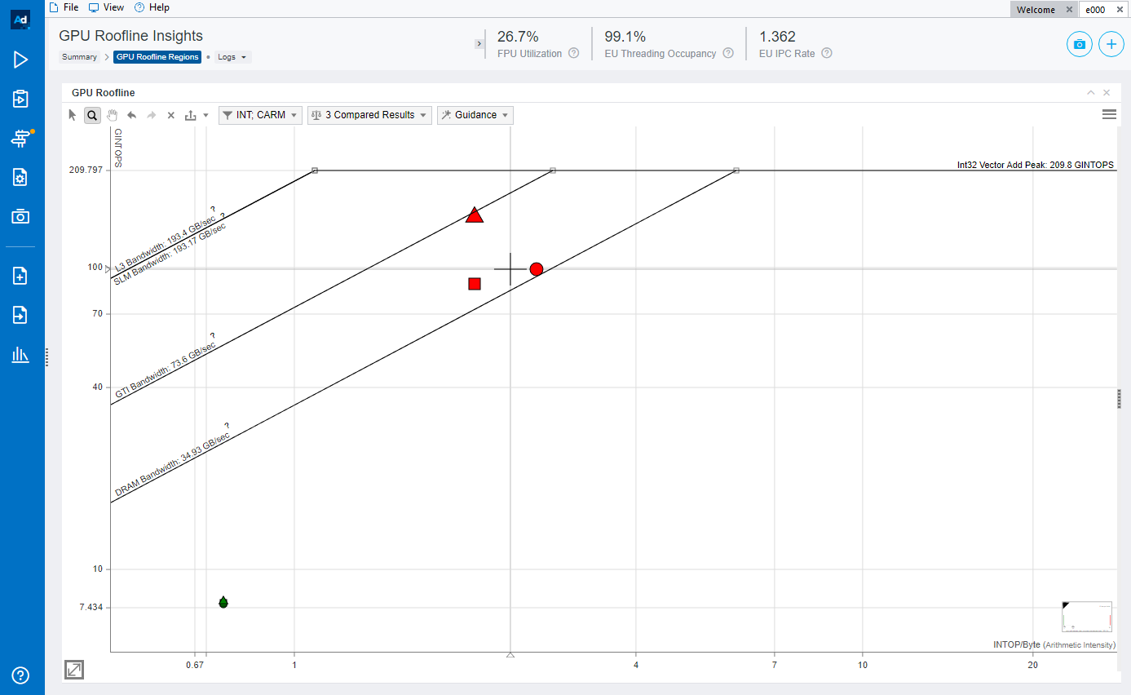
Advisor in action…
GPU Optimization
Three Genotypes + Phenotype
popcnt
not
and
Two Genotypes, No Phenotype
Two Genotypes, No Phenotype
popcnt
and
nor
nor
Transposed Dataset
1.7x
performance
improvement
1.7x
speedup
popcnt
and
nor
nor
Memory accesses are now more efficient!
We have now “block loads” versus a lot of gathers!
Notes:
0

Slide 70
Advisor in action…
GPU Optimization
Three Genotypes + Phenotype
popcnt
not
and
Two Genotypes, No Phenotype
Two Genotypes, No Phenotype
popcnt
and
nor
nor
Transposed Dataset
1.7x
performance
improvement
1.7x
speedup
popcnt
and
nor
nor
How can we improve this result?
Notes:
0

Slide 71
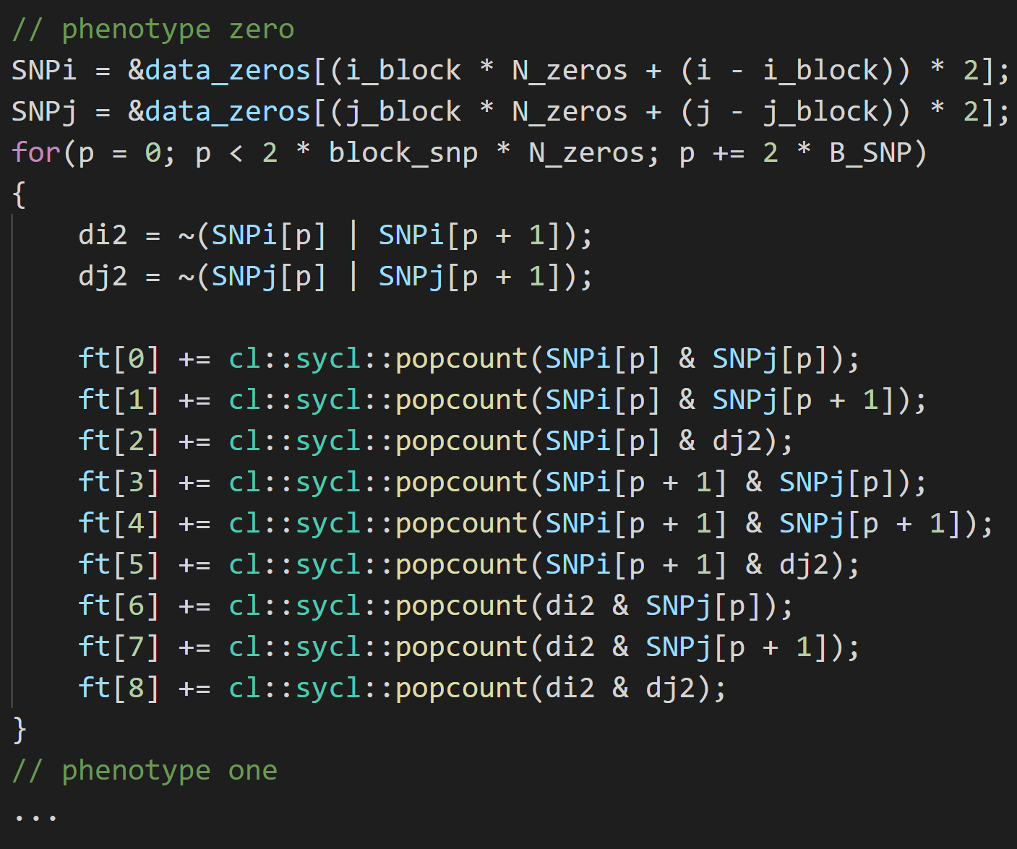


Data set tiling
GPU Optimization
Three Genotypes + Phenotype
Device code
popcnt
not
and
Two Genotypes, No Phenotype
The data set is iterated by rows of size 2 * B_{SNP}
popcnt
The 3rd genotype is computed
and
nor
nor
Transposed Dataset
popcnt
The frequency table is filled using 2 genotypes
and
nor
nor
Dataset Tiling
popcnt
and
nor
nor
Tiling our dataset to squeeze the maximums!
Using a tile size of B_{SNP} we can maintain constant
access stride
Notes:
0

Slide 72
Advisor in action…
GPU Optimization
Three Genotypes + Phenotype
popcnt
not
and
Two Genotypes, No Phenotype
Add another trace to compare
Two Genotypes, No Phenotype
Select the file traces/v4.advixeexpz
popcnt
and
nor
nor
Transposed Dataset
popcnt
and
nor
nor
Dataset Tiling
popcnt
and
nor
nor
Notes:
0

Slide 73
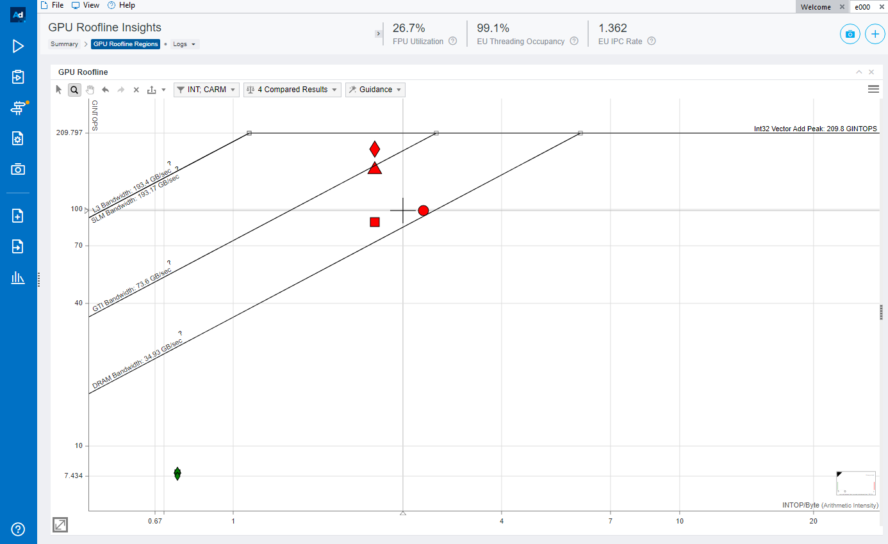
Advisor in action…
GPU Optimization
Three Genotypes + Phenotype
popcnt
not
and
Two Genotypes, No Phenotype
Two Genotypes, No Phenotype
popcnt
and
nor
nor
Transposed Dataset
popcnt
and
nor
nor
Dataset Tiling
popcnt
and
nor
nor
Notes:
0

Slide 74
Advisor in action…
GPU Optimization
Three Genotypes + Phenotype
popcnt
not
and
Two Genotypes, No Phenotype
Two Genotypes, No Phenotype
popcnt
and
nor
nor
1.8x
performance
improvement
3.6x
Transposed Dataset
speedup
popcnt
and
nor
nor
Dataset Tiling
Further performance increase!
The performance is now close to the compute roof!
popcnt
and
nor
nor
Notes:
0

Slide 75
Job done!
GPU Optimization
Three Genotypes + Phenotype
popcnt
not
and
Two Genotypes, No Phenotype
Two Genotypes, No Phenotype
popcnt
and
nor
nor
1.8x
performance
improvement
3.6x
Transposed Dataset
speedup
popcnt
and
nor
nor
Dataset Tiling
Job done!
popcnt
and
nor
nor
Notes:
0

Slide 76

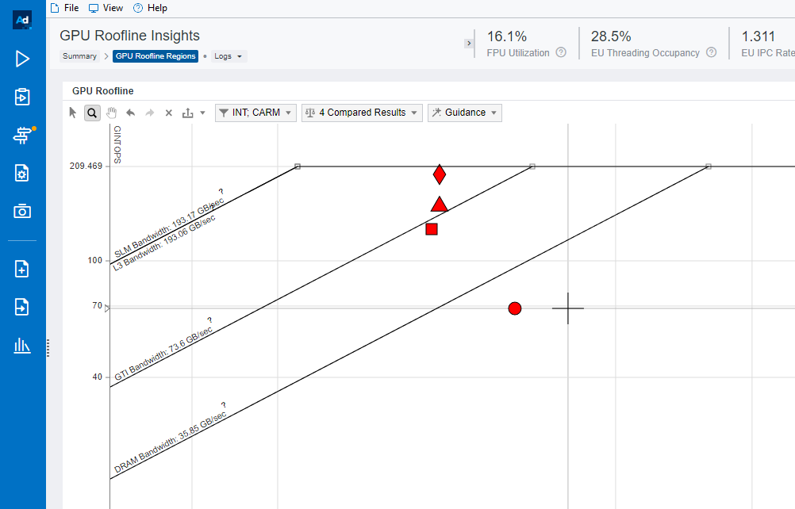
DPC++ VS OpenCL
DPC++ Roofline results
OpenCL Roofline results
Different performance, similar optimization pattern
Conclusion: DPC++ shows great
potential when compared to
the established OpenCL model
Notes:
0

Slide 77
PERFORMANCE
POWER
ENERGY-EFFICIENCY
CASE-STUDY
Conclusions
Special thanks to Sujata Tibrewala, Zakhar A. Matveev and Intel Advisor team, and Igor Vorobtsov
Intel DevMesh Project - Boosting epistasis detection on Intel CPU+GPU systems | Intel DevMesh
D. Marques, A. Ilic, Z. Matveev and L. Sousa, “Application-driven Cache-Aware Roofline Model”, Elsevier FGCS (2020)
R. Nobre, A. Ilic, S. Santander-Jiménez, L. Sousa, “Exploring the Binary Precision Capabilities of Tensor Cores for Epistasis Detection”, IPDPS (2020)
R. Campos, D. Marques, S. Santander-Jiménez, L. Sousa, A. Ilic, “Heterogeneous CPU+ iGPU Processing for Efficient Epistasis Detection”, EuroPar (2020)
A. Ilic, F. Pratas, L. Sousa, “Beyond the Roofline: Cache-Aware Power and Energy-Efficiency Modeling for Multi-Cores”, IEEE Trans. on Computers (2017)
A. Lopes, F. Pratas, L. Sousa, A. Ilic, “Exploring GPU performance, power and energy-efficiency bounds with Cache-aware Roofline Modeling”, ISPASS (2017)
A. Ilic, F. Pratas and L. Sousa, “Cache-aware Roofline Model: Upgrading the Loft”, IEEE Computer Architecture Letters (2014)

Slide 78

Thank you!
Supported by Intel Corporation, Portuguese FCT national funds and EuroHPC Joint Undertaking under projects UIDB/50021/2020, PTDC/CCI-COM/31901/2017 (HiPErBio), and grant agreement no. 956213 (Sparcity)

